Slide 1
Acronis MDR* powered by Novacoast
*Managed Detection & Response

Slide 2
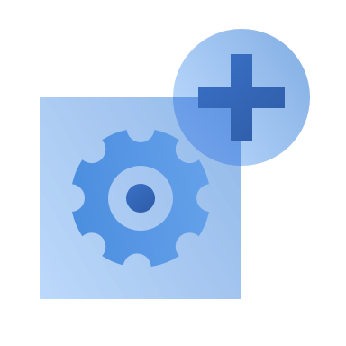
The need for MDR
Only advanced security can combat advanced attacks
Breach is inevitable – you need to be prepared
Resources are more and more limited
More than 60% of breaches involve some form of hacking
On average, it takes organizations 207 days to identify a breach
70 days to contain a breach USD 4.35 million – average total cost of a data breach
Worldwide, the cyber workforce shortfall is approximately 3.5 million people
76% of security and IT teams struggle with no common view over applications and assets
Sources: “Data Breach Investigations Report’, Verizon, 2022”; “Cost of data breach report”, 2022, IBM Security & Ponemon Institute; “Costs and Consequences of Gaps in Vulnerability Response,” ServiceNow, 2020, Investigation or Exasperation? The State of Security Operations”, iDC, Cybersecurity Ventures
Notes:
So, what’s driving the adoption of EDR across organizations?
Modern threats are becoming more frequent and complex, requiring advanced security controls to combat.
Without such (e.g. EDR) organizations are under increased risk of attacks, as majority of successful attacks now implement techniques that bypass more basic defenses.
In addition, service providers are blind to threats that bypassed other layers
With current average time to contain a breach being a few months, and the cost hitting an all time-high – businesses of all sizes need effective controls to remediate and recover from breaches with ease and speed to minimize the impact of business
Compliancy is another driver for EDR, affecting many businesses regardless of size.
On one side most of regulations are imposing strict requirements like timelines of reporting security incidents, or data protection controls like Disaster recovery.
On another side the majority of regulations are mentioning EDR as a must have solution.

Slide 3
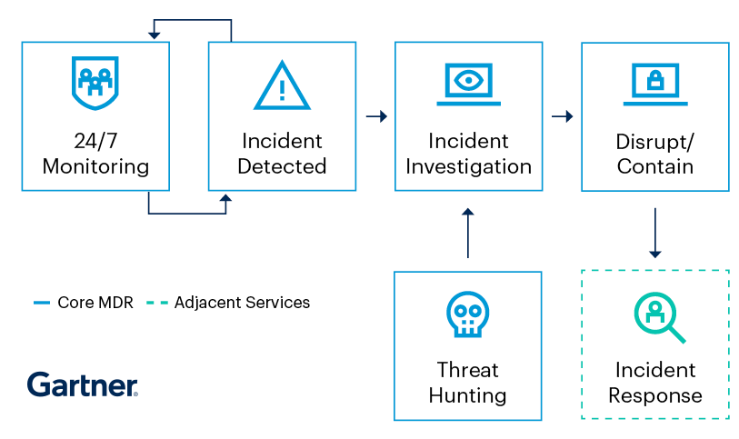
MDR – Managed Detection and Response
MDR services provide customers with 24/7 remotely delivered modern security operations center functions. These enables organizations leverage outsourced monitoring, rapid detection, investigation, containment, response to and remediation of threats and attacks.
Why MSPs need MDR
Reduce the risks of advanced threats, targeted attacks, hacking
Amplify or offload service delivery team, yet ensure world-class 24/7 detection & response services are delivered to clients
Strengthen regulatory compliance for clients
Increase competitiveness on the market to attract and retain more business

Slide 4
Overcome the limitations of existing MDRs with Acronis
Existing MDR solutions have siloed focus on stopping threats with partial remediation capabilities, requiring further integrations that bring up the complexity, costs, and time-to-value on your end.
Limitations
Partial remediation with limited business continuity
Solution sprawl
MSP enablement
Acronis opportunity
Integrated remediation & recovery that can be fully outsourced
Multi-service consolidation under one roof
True SP-partner approach
Notes:
Main market challenges
Urgent need for democratization of EDR/XDR (cost & complexity reduction) – urgent need for down-market solutions/services for midmarket and SMB customers who need to combat advanced attacks, but are even more challenged by the costs/skills barriers for operationalization and usage of these tools.
Require capabilities to only stop threats but ensure true business continuity, while decreasing complexity and solution sprawl.
MSP enablement, channel conflict and cybersecurity workforce gap – while security programs become more resource-intensive, the security workforce gap keeps growing, especially for MSPs. In parallel service providers now compete directly with suppliers for talent, client relationships, and margins pricing them out of down-market.
Need to improve incident analysis and response times – Mean time to contain a threat once detected is now 70 days, according to IBM and Ponemon Institute (The Cost of Data Breach Report, 2022) – it is improving but still on average it takes months due to the complexity of manual analysis, skills bar and additional integrations needed for holistic response, including recovery.
Limited compliance awareness or support for DR – As regulatory continues to change rapidly and with poor standardization, DETECT, RESPOND, RECOVER must be rapid and fully integrated to avoid potential regulatory penalties and reputation damage due to often public disclosure requirements. E.g. some regulations like GPDR require to report breaches within a specific time frame (72 hours).
Acronis has an opportunity to lead with success by making solutions more accessible and adoptable,
For 2023, Acronis can capitalize on the whitespace by leveraging:
Innovation to help better democratize EDR down-market - we use innovation and integration to make EDR accessible for SMB and mid-market organizations, enabling them to finally combat advanced threats with efficient technology scalable to their needs and budget.
Solution consolidation and centralized service management across the NIST framework – decrease complexity and solution sprawl with a single integrated platform across IDENTIFY, PROTECT, DETECT, RESPOND, RECOVER to enable partners to ensure true business resilience and continuity.
True SP-partner approach – Acronis is an SP-partner focused company and doesn’t compete with its partners with direct-to-end-customer MDR services while providing SP-class technologies that enable to launch and/or streamline detection and response services without high staffing, training, and cost requirements through automation and innovation.
Rapid incident analysis and response – enable SPs with established cybersecurity portfolios to cut incident-analysis to a few minutes with automatic, AI-driven interpretation of attack to respond more rapidly and with just a single click.
Compliance – empower SPs to report on breaches with the speed and confidence they need guided by an MSP-class EDR

Slide 5
Acronis MDR powered by Novacoast - Overview

Slide 6
Acronis MDR powered by Novacoast
Simplified, continuous, effective endpoint security service designed for services providers to deliver unmatched business resilience to clients while optimizing your resource allocation
24/7/365, outsourced, world-class SOC
Best-of-breed remediation, including recovery
Prioritized threat visibility in a single platform for all your services
Amplify security effectiveness with 24/7/365 monitoring & support by a world-class SOC team, outsourcing your day-to-day operations to focus your resources on strategic initiatives.
Unlock unmatched business continuity leveraging remediation that includes seamless recovery with options to be completely outsourced.
Get prioritized visibility on security incidents in a platform that integrates data protection, cybersecurity, and endpoint management services and unlock up to 60% better TCO through consolidation.

Slide 7
Acronis partnership with Novacoast
Novacoast is an international cybersecurity company specializing in IT services and software development.
25+ year proven track record in the industry
Novacoast has built and maintains IT security solutions for some of the world’s largest private and public organizations (Managed SIEM, DLP, EDR, PAM, IR, etc.)
MDR team is comprised of hundreds of specialists with backgrounds in IT advisory, development and engineering, and managed services
Novacoast enhance Acronis EDR telemetry with proprietary SIEM & SOAR systems for additional analysis
Based in Southern California, USA
Notes:
Advanced Security + EDR enables a more holistic endpoint protection than any point solution. Instead of just stopping the breach like point solutions, you can leverage the full power of a single platform with integrated capabilities, enabling unmatched business resilience:
Investigate further using remote connection and forensic backup
Contain threats by network isolating the affected workload
Remediate by killing malware processes, quarantining threats, and rollbacking changes.
Prevent incidents from reoccurring with software patch management and by blocking analyzed threats from execution
Ensure unmatched business continuity with integrated recovery capabilities, including attack-specific rollback, file- or image-level recovery, and disaster recovery
There is no EDR solution out there capable of providing such holistic response capabilities, including recovery.

Slide 8
24/7/365 outsourced SOC at your disposal
Amplify your team’s security effectiveness and optimize resource allocation
Fully outsource your endpoint protection services via Acronis certified MDR partner – Novacoast:
Effortless provisioning – single-click deployment with outsourced SOC handling all the rest
24/7 continuous monitoring of client endpoints – to identify threats
Expedited investigations from security analysts – leveraging rich telemetry, threat intel, and deep forensics
Event triage and prioritization – with real-time alerting
Endpoint isolation & threat containment – to prevent further spread
Rapid response, including recovery – can be fully outsourced
Continuous reporting – demonstrate your value to clients
Technology Stack
Security
software stack
Auxiliary software
Mandatory*
Optional
EDR
SASE (SSE – CASB, ZTNA, SWG)
DLP
Email Security
Threat Intelligence
Backup
DR
Antimalware
Network Security
Cloud (CSPM,
CWPP, CNAPP)
Identity
Breach & Attack Simulation
RMM
PSA
MDR platform
APIs
SIEM and SOAR
Telemetry collection, aggregation & correlation?
Workflows
Response
Incident Management & Ticketing (lifecycle management, SLA, assignment, dashboard)
Notes:
An important value of Advanced Security + EDR is that it enables service provides to analyze attack in minutes and unlock rapid response with automated human-friendly interpretation of the attack
Enables your team to focus its efforts on what matters with prioritized visibility of suspicious activates across endpoints and emerging threat intelligence feeds
The solution provides a complete visibility into the attack chain to understand
How did it get in?
How did it hide its tracks?
How did it cause harm?
How did it spread?
This enables incident investigation to be done in minutes rather than hours without requiring rigorous training or resource-intensive operations

Slide 9
An MDR that stops the breach and ensure business continuity
Succeed where point solutions & MDRs based on them fail. Unlock the full power of integrated remediation & recovery for unmatched business resilience
Instantaneous threat containment – by network isolating the affected workload
Rapid remediation – killing malicious processes, quarantining threats
Vulnerability management – closing open vulnerabilities, leveraged in attacks
Ensure unmatched business continuity – integrated recovery, including attack-specific rollback, file- or image-level recovery, and disaster recovery, that can be fully outsourced
Get prioritized visibility across isolated incidents with a single-click remediation capabilities, or fully outsource your response.
Notes:
Advanced Security + EDR enables a more holistic endpoint protection than any point solution. Instead of just stopping the breach like point solutions, you can leverage the full power of a single platform with integrated capabilities, enabling unmatched business resilience:
Investigate further using remote connection and forensic backup
Contain threats by network isolating the affected workload
Remediate by killing malware processes, quarantining threats, and rollbacking changes.
Prevent incidents from reoccurring with software patch management and by blocking analyzed threats from execution
Ensure unmatched business continuity with integrated recovery capabilities, including attack-specific rollback, file- or image-level recovery, and disaster recovery
There is no EDR solution out there capable of providing such holistic response capabilities, including recovery.

Slide 10
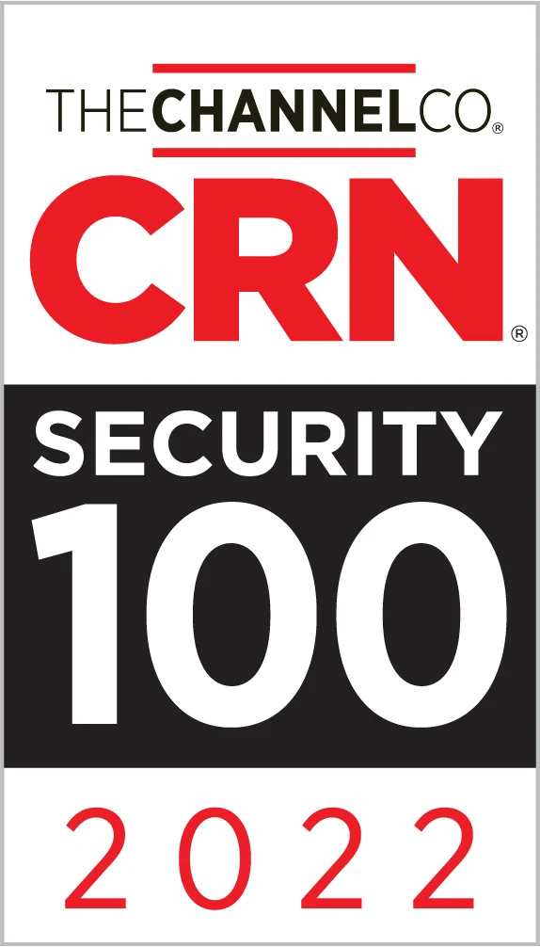
Leverage a single platform for all your services
Unlock the full power of a platform with consolidated capabilities to rapidly turn-up services
One
Agent
Policy
Console
License
Vendor
High-value & high-margin services scalable across varying clients:
Anti-malware, web protection, email security, EDR, DLP, MDR, powered by award-winning detection technologies
Pre-integrated with best-of-breed data protection and endpoint management
Provisioned and managed via a single agent & console
Single-click deployment of services
Faster onboarding & better ROI, faster time-to-value, and less support tickets to manage than point-solution-approaches
Up to 60% improved TCO and easier service-tiering and billing using a single, integrated platform
Rapid service provisioning
Full protection across NIST
Better performance

Slide 11
Acronis MDR: Licensing
C
Flexible licensing model allows partners to choose the tier of MDR service that fits their business needs
Tier 1 – Simplify endpoint protection and amplify your team’s security effectiveness
Tier 2 – Fully outsource endpoint security operations for peace of mind and business resilience assuredness
Advanced MDR will be licensed per-workload, as a service on top of Advanced Security + EDR pack (applicable to both per-workload and per-GB licensing models of Acronis Cyber Protect Cloud)
Included | Tier 1 | Tier 2
24/7 support by an outsourced SOC | Included | Included
24/7/365 monitoring to identify threats | Included | Included
Event triage & prioritization with real-time threat alerting | Included | Included
Instant threat containment by SOC team | Included | Included
One-click remediation and restoration capabilities | Included | Included
Expedited threat remediation by MDR team |  | Included
Outsourced attack rollback & recovery |  | Included
Outsourced patch management, as part of response |  | Included
Notes:
EDR will be delivered as a new pack: Advanced Security + EDR. (it’s not an extension of the existing Advanced Security pack, but a standalone pack)
It will contain all functionalities of Advanced Security
Applicable to per-GB and per-workload licensing models
Based on the datacenter the commitment price varies

Slide 12
Example: How to package services with Acronis MDR
$49
$89
$149
Acronis MDR
Tier 1:
Tier 2:
Tier 3:
Backup
Anti-malware
Anti-ransomware
Web protection
File sync & share
Detection and response service
Backup
Anti-malware
Anti-ransomware
Web protection
File sync & share
Email security
Asset tracking and management
Health and performance monitoring
Remote management and assistance
Firewall
Password management
Detection and response service
Backup
Anti-malware
Anti-ransomware
Web protection
File sync & share
Email security
Asset tracking and management
Health and performance monitoring
Remote management and assistance
Disaster recovery
Password management
Network security
Network management
Acronis Cyber Protect Cloud, MSP-managed
Third party
Notes:
Example how you can bundle your services with Acronis
Blue – services you can deliver with Advanced Security + EDR
Green – other services that you can deliver with Acronis to enhance your service tech stack

Slide 13
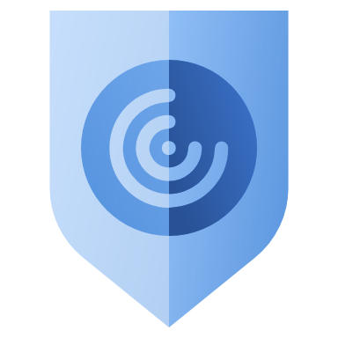
Acronis MDR: Top 5 use cases
Amplify team effectiveness & optimize resource allocation
Identify and block attacks before breach
Respond before damage is done
Enable compliance and cyber insurance
Consolidate solutions
Notes:
Let’s review the top use cases for Acronis MDR:
Amplify effectiveness & optimize resource allocation
Monitroing & support by a 24/7/365 SOC
2. Detect and block attack before breach
24/7 monitoring of endpoints by world-class SOC
Block common threats with award-winning endpoint protection
Identify advanced threats and get rapid, deep analysis by security experts
3. Respond before damage is done
Event triage, prioritization, real-time alerting for security incidents by expert analysts
True business continuity with streamlined integrated remediation and recovery, that can be fully outsourced
Limit attack surface for future protection by closing open vulnerabilities leveraged in the attack – can be fully outsourced
4. Enable compliance and cyber insurance
Reporting on incidents across endpoints by security analysts
Classify sensitive data, and report on incidents that concern such data with priority
Collect forensic data
5. Consolidate solutions
Rapidly launch & scale through an MSP-class platform that unifies cybersecurity, data protection & endpoint management
Reduce TCO by up to 60% with unified service management
Enabling cyber insurance
Cyber insurance is a hot topic in the cybersecurity industry as organizations looks for more ways to reduce the risks of the raising threat landscape and limit the damage of potential incidents and ensure piece of mind. However, a requirement for enabling cyber insurance is to have deep endpoint protection capabilities, spanning across prevention, detection, and response. In the same time, for most organizations without high security budgets, cyber insurance still remains an endeavor with high cost, impacted by the thoroughness of businesses’ security program, adding other layers of cost and complexity. Acronis Cyber Protect Cloud with Advanced Security + EDR enables you to unlock cyber insurance to limit the impact of cyber risks, including supply-chain ones, with endpoint protection capabilities spanning across identification, protection, detection, response, and recovery. The solutions further reduces cyber risks and respectfully cyber insurance costs through additional data protection, including backup, disaster recovery, and data loss prevention for sensitive information that also strengthens regulatory compliance.
Strengthen compliance and report with ease and confidence
Every organization is aware of the multitude of regulations protecting sensitive data against cyber risks. Such regulations increase the cybersecurity and data protection requirements that organizations of all size have to meet. However regulatory compliance is a complex, multi-dimensional, and continuous process, requiring high level of expertise, multiple technologies, and long implementation processes.
This complexity limits visibility and inadvertenly increases compliance risks, ultimately leading to the increased frequency of huge fines levied on organizations by regulatory bodies. An inability to report a breach within a strict time frame can lead to detrimental fines for businesses.
Adv EDR enables you to detect, stop, and remediate, and report on attacks with the ease and speed you require.
Solution consolidation across NIST to reduce costs and streamline management
Cybersecurity programs have become demanding and complex for organizations of all sizes. While small-to-mid sized IT team are struggling to implement more advanced security solutions to answer the rising complexity of the threat landscape, larger organizations struggle with solution sprawl and the inefficiency and high costs of managing multiple point solutions. This leads to severe management complexity for security and IT teams’, negatively impacting the protection, visibility, and response, and serves as a barrier for service providers to expand their service stack or secure profitable margins.
Acronis Cyber Protect unifies multiple cybersecurity, data protection, and management capabilities, enabling you to centrally provision and manage multiple cyber protection capabilities including anti-malware, email security, backup & DR, endpoint management, data loss prevention (DLP), and EDR (Q1, 2023). The integration enables consolidation to reduce costs and streamline management.

Slide 14
Cross-NIST protection with Acronis
IDENTIFY
PROTECT
DETECT
RESPOND
RECOVER
Acronis MDR powered by Novacoast
SW & HW inventory
Unprotected endpoint discovery
Data classification
Vulnerability assessments
Device control
Security configuration management
Patch management
DLP
Backup integration
Emerging threats feed
Exploit prevention
Search for IOCs of emerging threats
AI/ML-based behavioral detection
Anti-malware & anti-ransomware
URL filtering
Email security
Rapid incident prioritization & analysis
Workload remediation with isolation
Forensic backups
Investigation via remote connection
Rapid rollback of attacks
One-click mass recovery
Self-recovery
Pre-integrated with disaster recovery
Acronis Cyber Protect Cloud
Notes:
Following established industry practices, our new Advanced Security + EDR pack enables partners to deliver protection across NIST Cybersecurity framework with a single platform – Acronis Cyber Protect Cloud. NIST is a cybersecurity framework, maintained by US gov, that lists the standards, guidelines and best practices to manage cybersecurity risk. It’s one of the most established frameworks across the cybersecurity industry. The framework consists of 5 main functions from Identify to Recover. While most EDRs focus purely on Detect & Respond Functions of NIST, only with Acronis, SPs are able to deliver complete cyber protection Across NIST with a single platform, designed for service providers.

Slide 16
Acronis is a Leader in Cyber Protection
Swiss
Singaporean
Global-Local Presence
Digital World Protection Challenges
Acronis
Cyber Protect
Since 2008 Corporate HQ in Schaffhausen, Switzerland
Founded in 2003 in Singapore
2,200+ employees
34+ locations
150+ countries
26 languages
750,000 businesses
53 DCs globally
Complexity
Cost
Security
Privacy
Cyber protection is the 5th basic human need
2,800,000+ workloads protected
1,000,000+ attacks prevented
20,000+ service providers
Desktop
Mobile
Server
Microsoft 365
Zoom
Schaffhausen Corporate HQ
Singapore International HQ, Suntec City

