Slide 1
The ConnectSecure Platform
Hardening Your Attack Surface

Slide 2
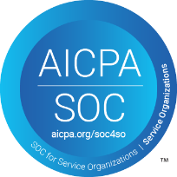
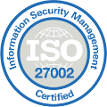
The Company
Leading automated scanning platform for vulnerability and compliance management
Headquartered in Tampa, FL
Development center in Bangalore, India
Principals have been serving the needs of IT practitioners for over 20 years
Over 2,000 partners. Prior to 2022 company was known as CyberCNS
SOC2, GDPR and ISO Certified
One of our critical and trusted partners in our cybersecurity practice
Committed to helping companies “Harden Their Attack Surface”

Slide 3
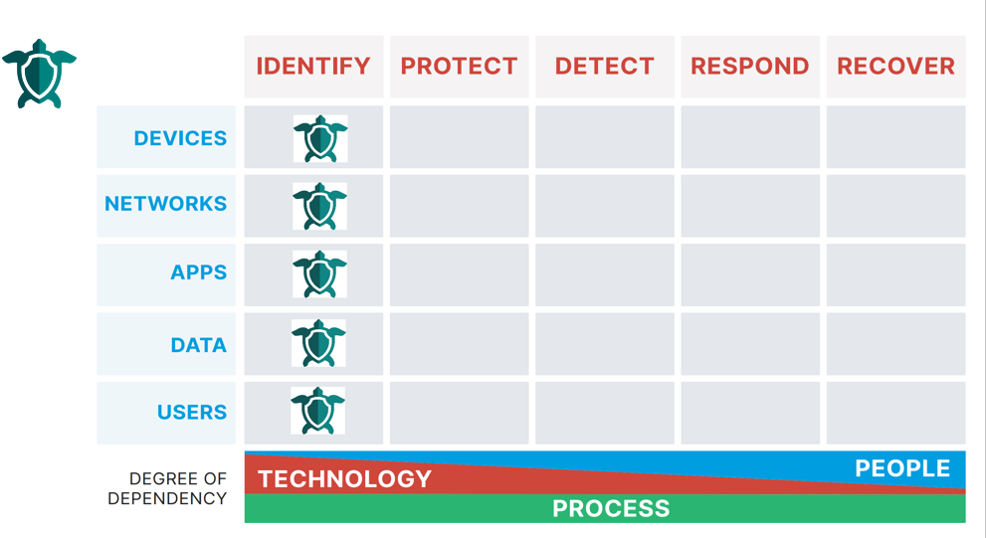
Positioning
NIST / CSF
…with respect to the NIST Framework & Cyber Defense Matrix
Primarily sits in the Identify sector, but provides some Protect functions, such as security patch management
Provides a critical set of functions that make up the “Left of Boom” sectors of the framework (Identify and Protect), which assist organizations in avoiding incidents that put them into an expensive “Right of Boom” mode (Detect, Respond, and Recover)
Covers all asset types, relevant to Identify, as defined in the Cyber Defense Matrix
ConnectSecure also supports over 10 compliance frameworks – such as HIPAA, PCI, CyberEssentials, etc. – with its scanning technology
Cyber Defense Matrix
“ConnectSecure gives me, and my clients, better data for better planning and better protection”
Karl Bickmore, CEO, Snaptech IT

Slide 4
Market Positioning
A complete All-in-One Solution. Don’t need to buy multiple modules to get comprehensive features and functions. Minimizes the overhead and administration of multiple licenses to do the same thing
Can be deployed on multiple devices and has both probe and agent implementation options depending on the needs of the environment
ConnectSecure responds to newly discovered vulnerabilities (CVEs) in near real-time based on its connection to the NVD
Incorporates the EPSS (Exploitation Severity System) so that vulnerabilities can be prioritized for remediation, ensuring we tackle the most critical ones first, optimizing your protection
Is integrated with our other IT management tools, so our technical teams save time and we can serve you with high efficiency

Slide 5
The Platform
All-in-One Vulnerability and Compliance Management Solution
Asset Discovery
Vulnerability Management
Patch Management
Compliance Management
Personal Identifiable Information (PII) Scanning
Attack Surface Scanning
Active Directory Auditing
Reporting (Custom, Standard, White-Label)

Slide 6
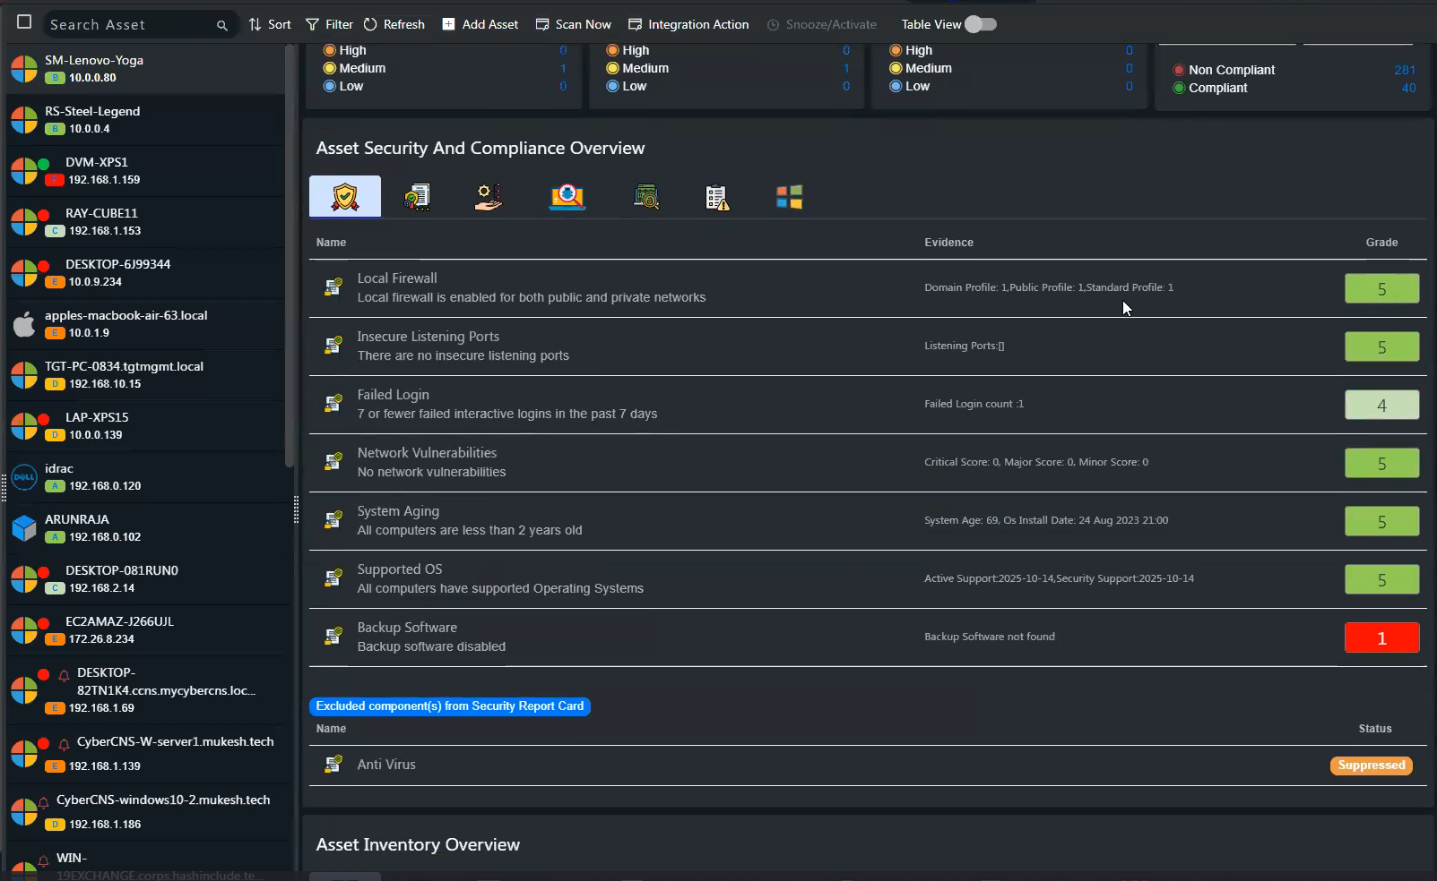
Asset Discovery
Use our Network probe technology to discover all the IP-based assets on your network(s).
Active Directory & Azure Active Directory Discovery: Discover assets effectively to maintain an accurate, real-time record of network users and computers.
Network Scan Findings: Identify potential network-based threats swiftly and deliver timely, actionable insights to bolster your security measures.
Detailed Inventory: Compile a comprehensive inventory of Applications, Extensions, Ports, Services, Interfaces, and more, for a full understanding of your digital landscape.
Network Probe Technology: Uncover all IP-based assets on your networks, providing not just visibility, but in-depth insights for informed decision-making.
Agent-Based Discovery: Gain a holistic view of your remote environments with the equivalent of a digital infrastructure watchdog.

Slide 7
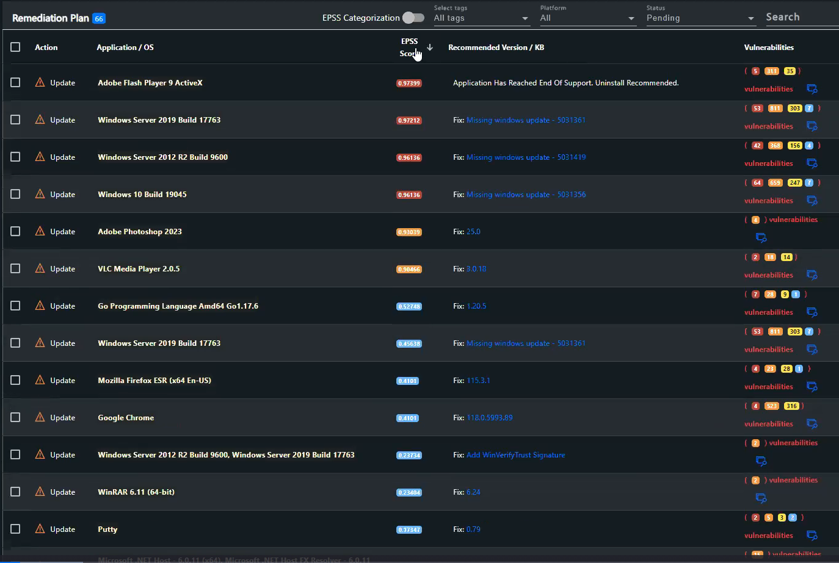
Vulnerability Management
Proactively identify and address security weaknesses, reducing the risk of cyberattacks and potential data breaches.
Automated Continuous Scanning and Remediation: Stay one step ahead of threat actors across all operating systems, Windows, Linux, Darwin, and ARM.​
Exploit Prediction Scoring System (EPSS): Prioritize and address security weaknesses based on real-world threat intelligence that assesses the risk of exploitation.
Missing Patches and Updates Identification: Equip your business to identify missing patches and updates in Microsoft Windows and third-party applications.
Support Over 600+ Third-Party Applications: Leave nothing to chance with support for whatever software you use.
Automated Scheduling for Continuous Scanning Capabilities: Make your security efforts consistent and rest easy knowing your systems are continuously monitored.
CVE Links: Move beyond identifying vulnerabilities to viewing the evidence and understanding your risks with links to Common Vulnerabilities and Exposures (CVE). Real-time threat intelligence via integration with NIST/NVD – currently 229,000+ CVE’s listed

Slide 8
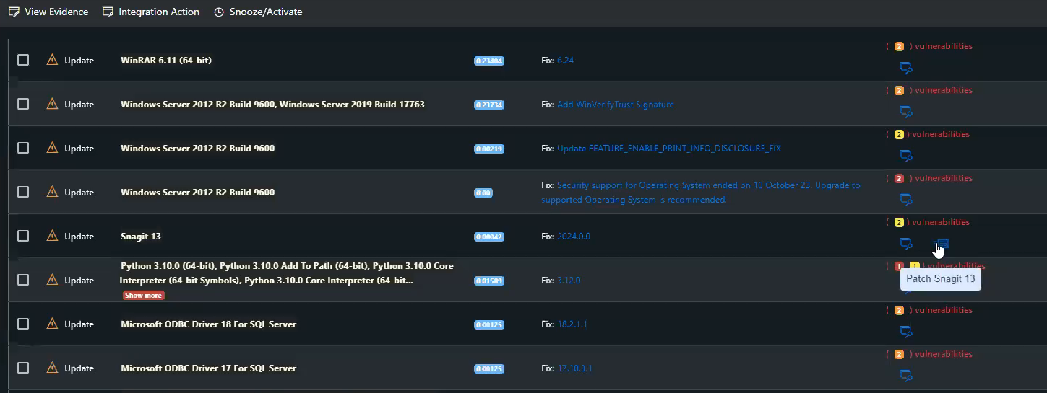
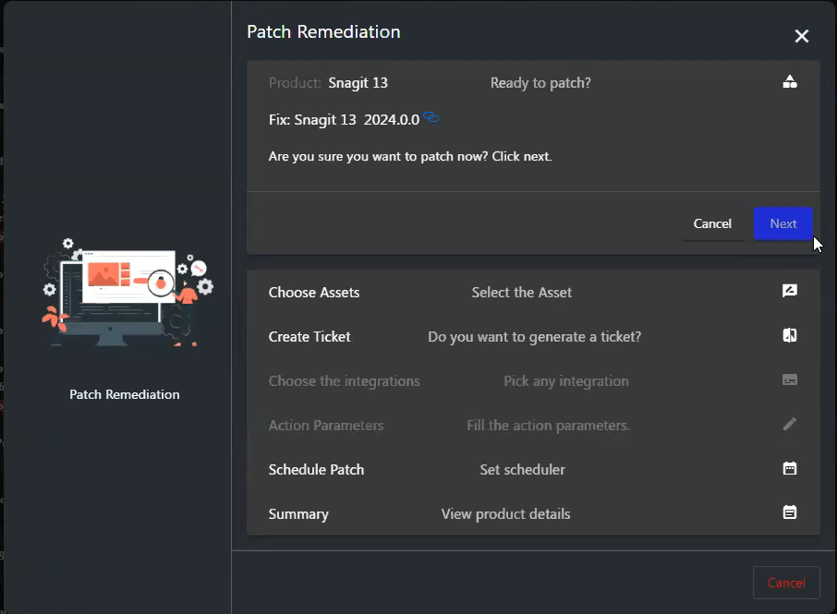
Patch Management
Ensure that software vulnerabilities are promptly addressed, minimizing the risk of security breaches and protecting valuable data.
Automated Third-Party Patching: Leverage our versatile patching engine with support for over 600 applications.
Microsoft Operating System Patch Checks: Validate that your Microsoft operating system patches are installed for complete peace of mind.
Patching Schedule Policy Control: Gain control over when and how your systems are patched.
Advanced Patch Customization: Tailor your patch management around your business needs with a range of customizable machine-, app-, and date-specific options.
Cross-Platform Support: Ensure comprehensive protection across diverse IT environments with support for Windows, Linux, and Darwin.
Insightful Reports and Dashboards: Stay informed and make data-driven decisions with valuable insights into your patching information.

Slide 9
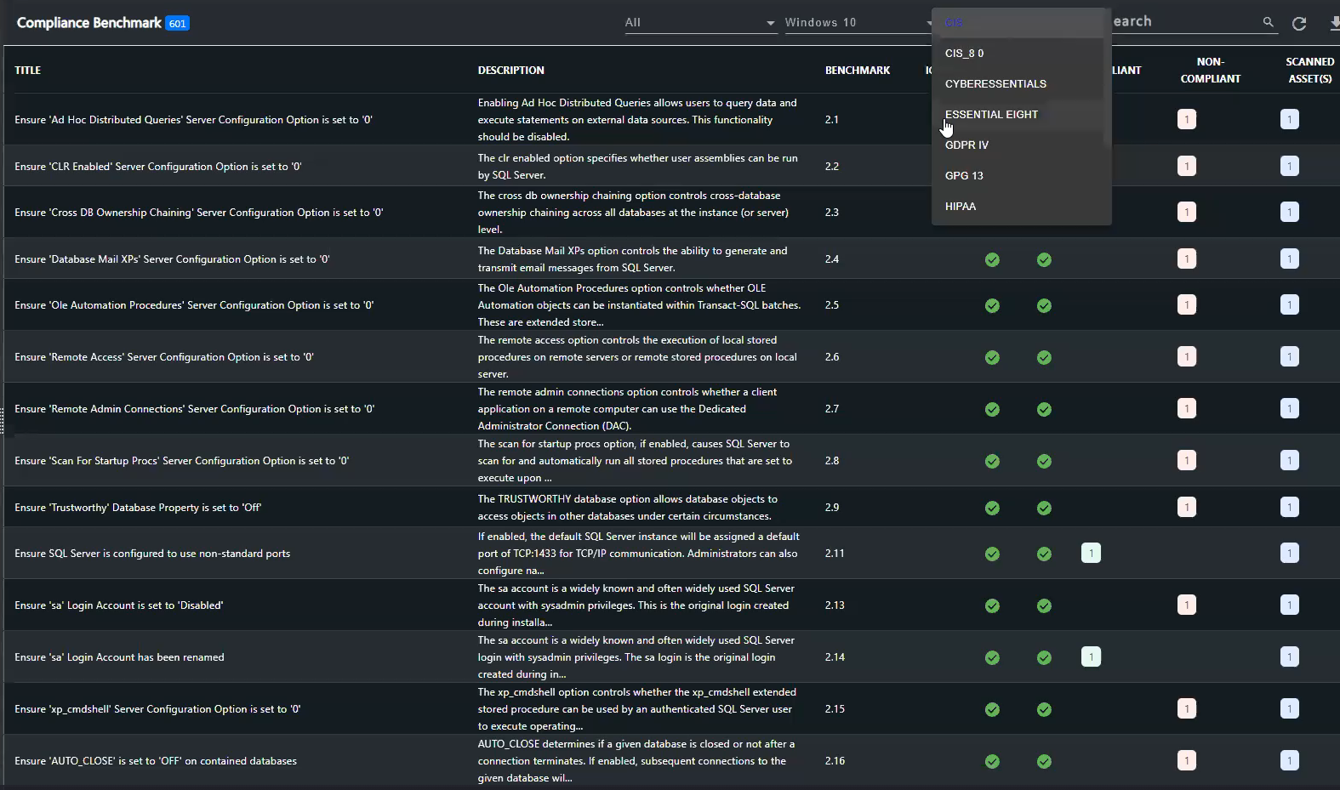
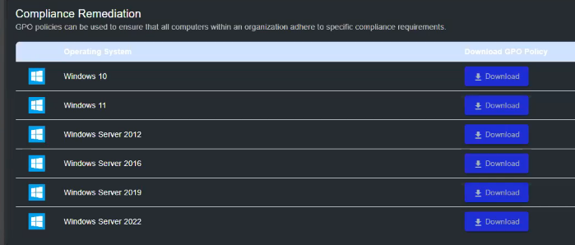
Compliance
Ensure you are in compliance with PCI DSS, HIPAA, GDPR IV, NIST 800-53, NIST 800-171, CIS, CIS 8.0, ISO 27002, Cyber Essentials, GPG 13 and Essential Eight.
Benchmarking Dashboard & Remediation Plans: Maintain compliance, evaluate policies, and devise strategic solutions to bolster your security posture.
Compliance Benchmarking Against Industry Standards: Measure and improve your policies with a comparative analysis that places your performance in the context of globally recognized standard frameworks.
White Labeled Compliance Reports: Present compliance data seamlessly with our white-labeled reports, offering tailored insights while preserving your brand integrity.
Multi-Level Compliance Benchmarking: Ensure compliance across your organization with our multi-level benchmarking feature that operates at both company and asset levels.
Global, Company, and Asset-Level Reporting: Track and evaluate your compliance with a versatile, multi-tiered approach that captures all levels—global, company, and asset.
Remediation & Assessments: Address non-compliance effectively with GPO policy downloads and strengthen your cybersecurity framework with an Assessments Module aligned with Cyber Essentials.

Slide 10
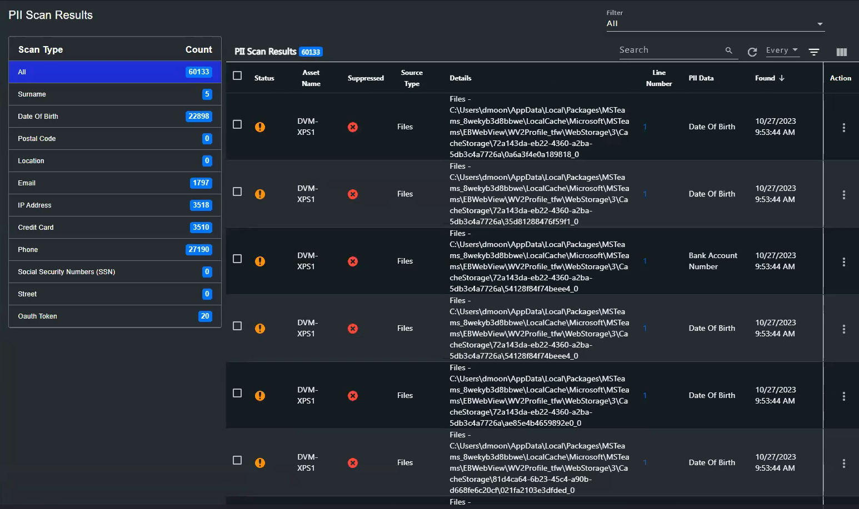
Personal Identifiable Information Scanning
Safeguard personal information from cyber threats, ensuring the privacy and security of individuals and organizations.
PII Scanning: Leverage wide-ranging coverage to ensure protection of PII data (Names, Credit Card numbers, Social Security Numbers, IP addresses, Email, Addresses).
Standard and Dashboard Reporting: Make informed decisions and track progress with ease with pre-built standard and dashboard reports.
Automated Scheduling: Remove the need for manual intervention and ensure non-stop protection with automated PII scanning.
Global and Company-Level Visibility: Gain a comprehensive view of PII data at both global and company levels, ensuring complete visibility across your organization.

Slide 11
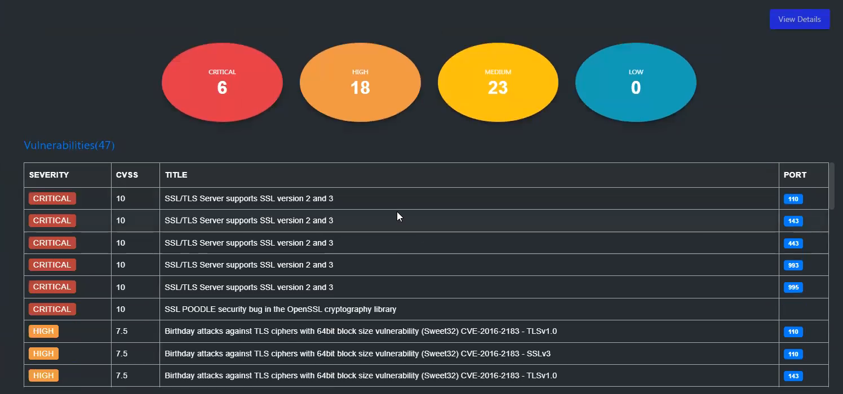
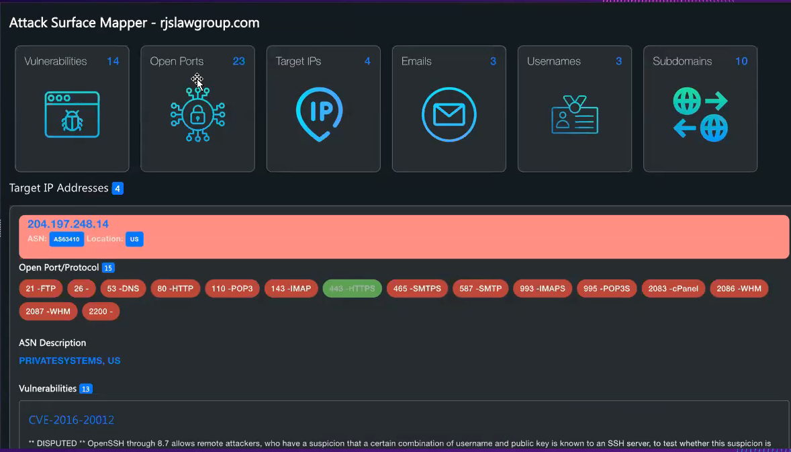
Attack Surface Scans
Perform external Deep Attack Surface Scans to identify and address vulnerabilities in digital infrastructure and enhance overall security.
Comprehensive Infrastructure Analysis: Foster cyber resilience by uncovering everything about an organization’s infrastructure that could potentially be exploited by malicious actors.
Complete Visibility: Scan network hosts, analyze web applications, enumerate subdomains, identify open ports, and perform other reconnaissance tasks to ensure all vulnerabilities are promptly identified and addressed.
Actionable Insights: Take the lead on proactive defense with a complete understanding of your attack surface.
Threat Intelligence: Identify open ports, target IPs, subdomains, emails/username compromised on the dark web.

Slide 12
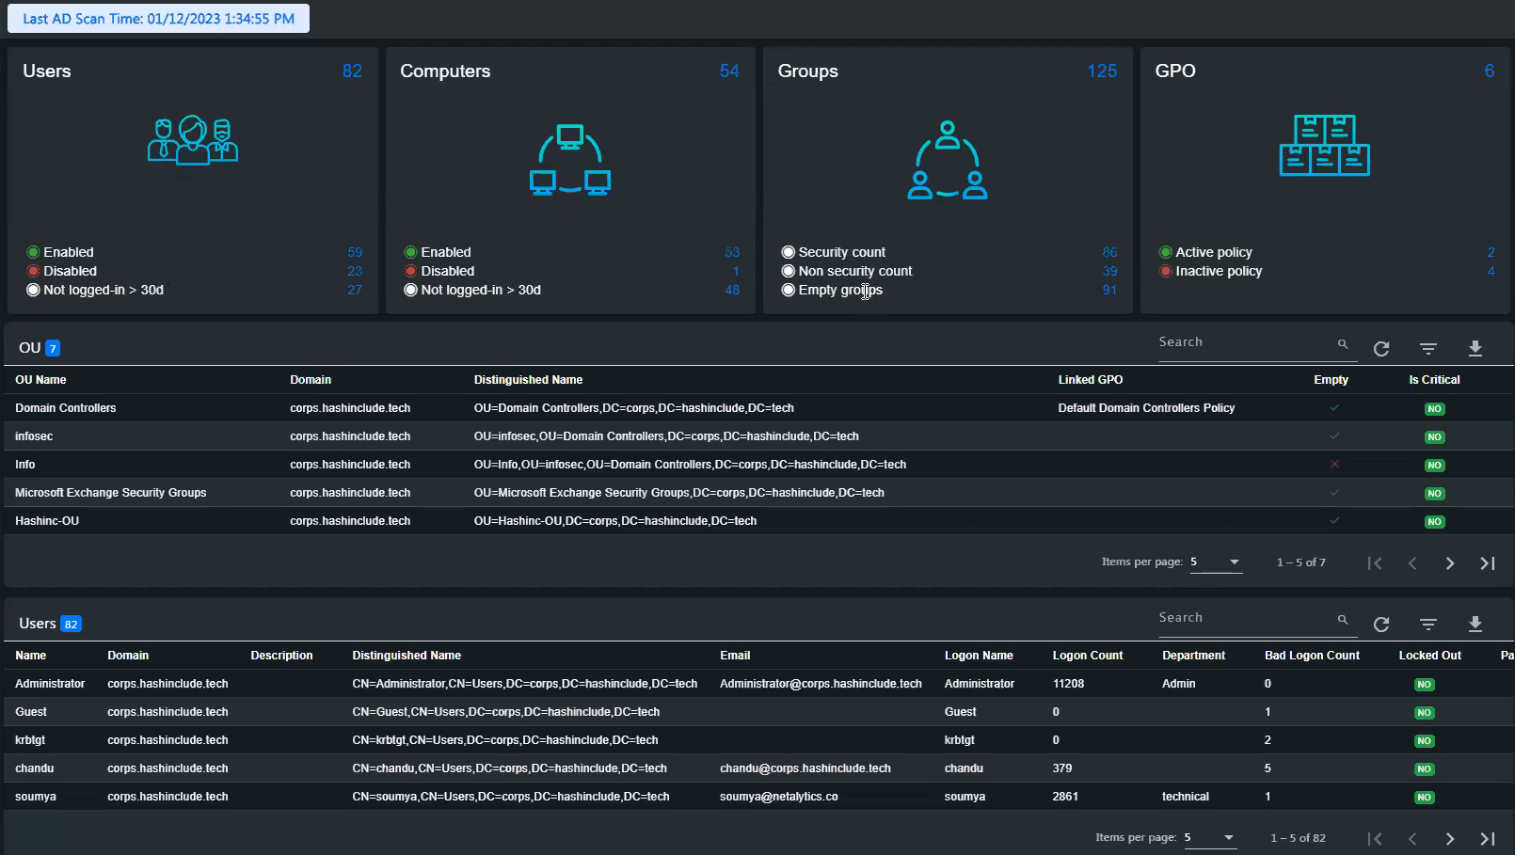
Active Directory Audit
Use on-site and Azure AD scanning to gain a complete picture of all assets and provide Office 365 Risk Scoring.
Users, Computers, Groups, and Group Policy Object Discovery: Gain a complete picture of all assets for full visibility and control.
Azure Discovery and Licensing: Discover Azure assets and manage licenses optimally for efficient usage and cost management.
Microsoft Secure Score Dashboard: Monitor your security posture and make data-driven improvements based on insights into your asset protection performance.
Alerts Sent to Integrations: Get immediate notifications of any anomalies or breaches with alerts sent to your preferred, integrated platforms, such as PSA, email, and more.

Slide 13
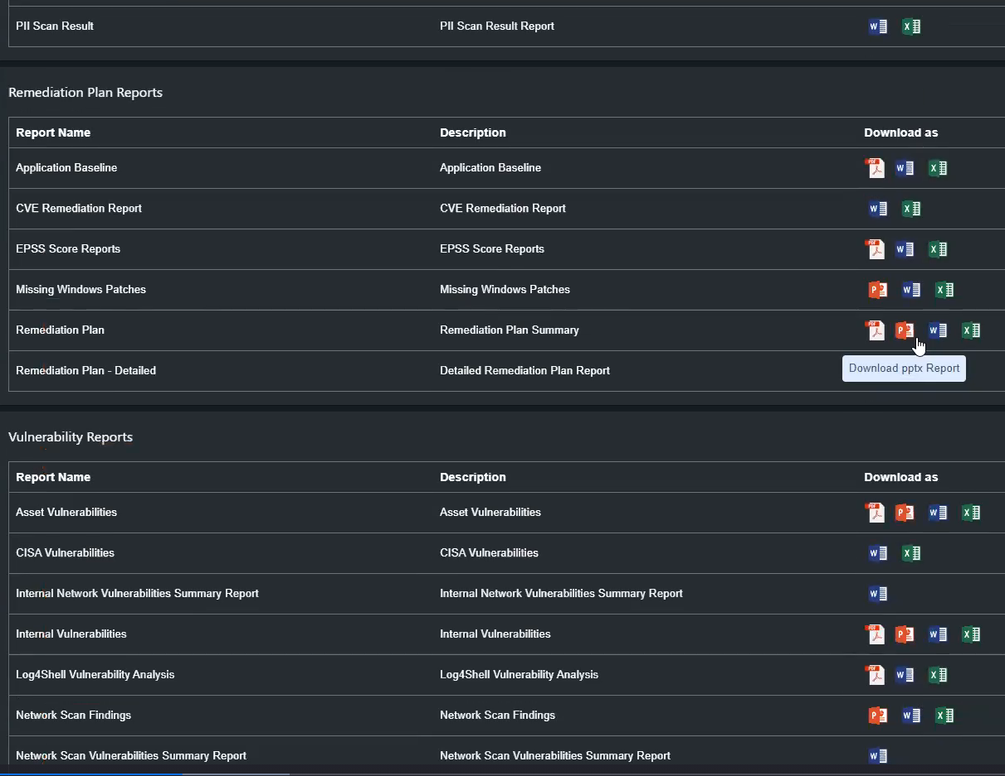
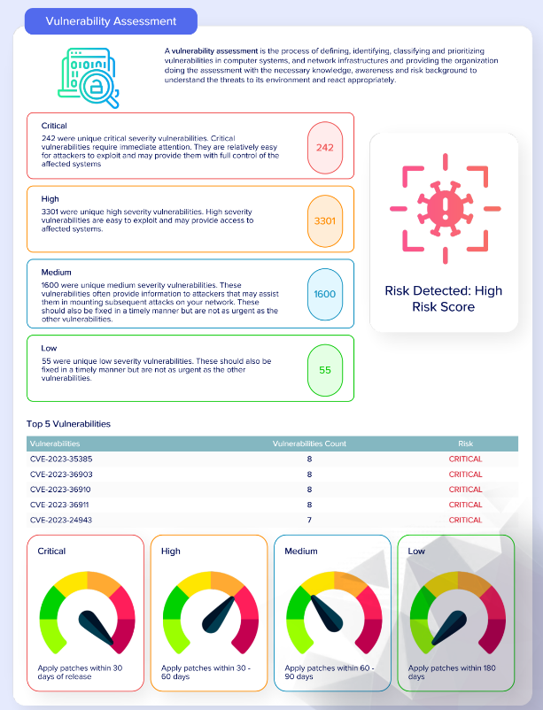
Reporting
Drag and drop to provide well-designed, customized reports in MS Office formats for technical and management reviews. A white label option is also available.
Role-Specific Reports: Access reports tailored to the different needs of Executives, Supervisors, and Engineers, all available for download.
Various Downloadable Formats: Select your preferred report format for download: PDF, Word, or Excel.
Comprehensive Reporting: Gain valuable insights into your IT environment with reports on AD Audit, Assets, Remediation Plan, Asset Level Compliance, Vulnerabilities, and much more.
Customizable Report Templates: Make the reports your own with branded options — logo, colors, fonts, sizes — that reflect the identity you desire.
Report Builder and Scheduler: Feature exactly the data you want to showcase and set automated delivery schedules.
Scan-Informed Reports: Tap into accurate and up-to-date information obtained from comprehensive scans.

Slide 14
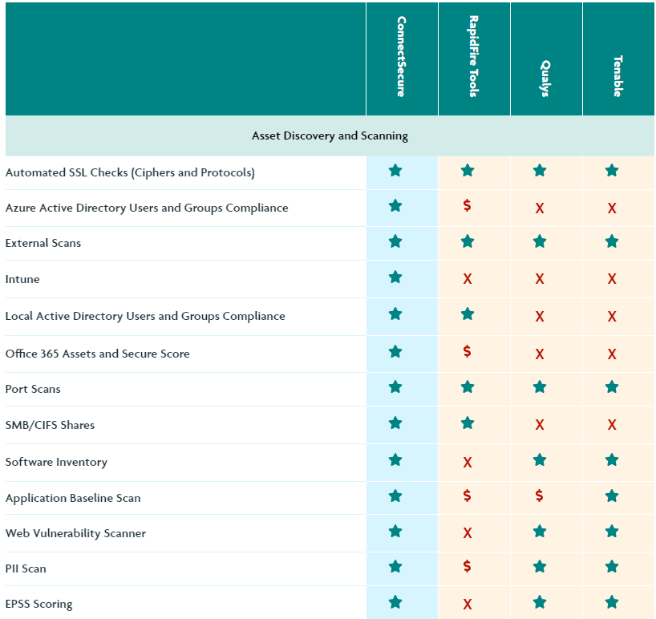
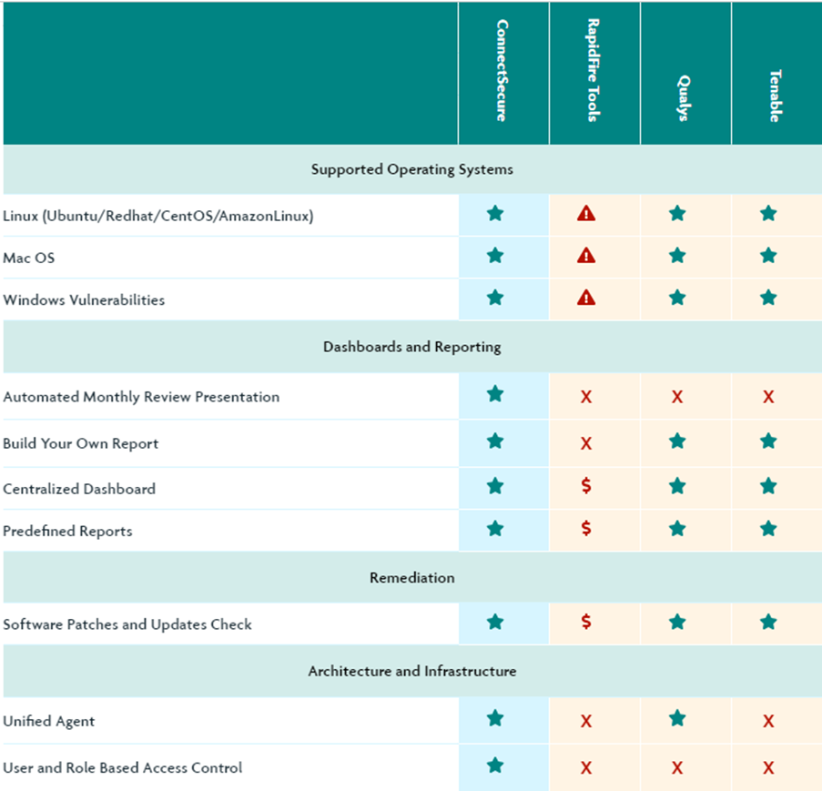
Competitive Positioning

Slide 15
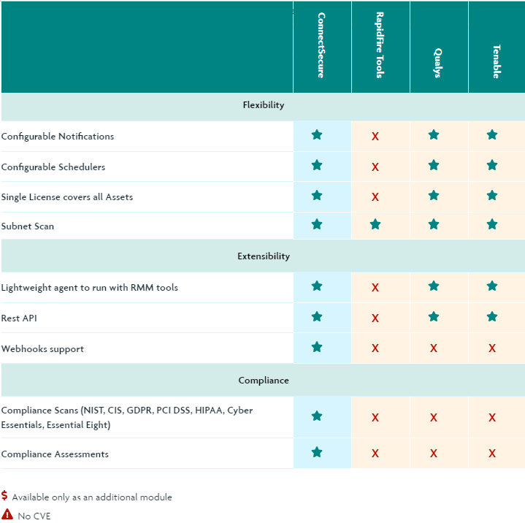
Competitive Positioning

Slide 16
Wrap Up Slide
MSP Content on this slide

Slide 17
Thank you!

