Slide 1
MDM Made Simple
Brian

Slide 2
MaaS360 Partner Training Program
Sales and Marketing
  Learn how to market, position and sell MaaS360
  2 one hour sessions
Implementation and Technical Support
  Learn how to implement and support MaaS360
  3 sessions, 1-2hrs per session
Partner Communications and Resources
  Learn how to interact with Fiberlink’s internal teams and additional resources you can leverage
  1 one hour session

Slide 3
MaaS360 Implementation and Support
Session 1:
MaaS360 MDM Technical Overview
  Audience: Technical Sales, Engineering
  Duration: 1 -2 hours
  Description: High-level of MaaS360 MDM platform
  Format: Webinar and hands on setup
MaaS360 MDM for iOS and Android
  Description: Walkthrough of MaaS360 customer provisioning, device enrollment and management
Session 2:
MaaS360 Cloud Extender Architecture
  Audience: Technical Sales, Engineering
  Format: Webinar and hands on setup
  Duration – 1- 2 hours
  Description – Architectural overview of MaaS360 Cloud Extender and customer pre-requisites
MaaS360 MDM for EAS/Notes and Blackberry
  Description: Install and configure MaaS360 Cloud Extender in partner test environment
  Prerequisites: Server or virtual server that has access to a test environment containing Exchange 2007/2010/Notes 8.5.2, BlackBerry Enterprise Server 5.01 or higher
Session 3:
Technical Support & Review
  Format: Webinar
  Duration: 1 hour
  Description: Common issues and resolution, Portal Administration, Accessing Fiberlink Support & MDM Services review
Notes:
Product Mgmt / CE / CS

Slide 4




















About Fiberlink
Diverse Range of Customers
Founded in 1991
Enterprise Mobility Management (EMM)
MaaS360 Platform
100% Cloud-Based
Over 1M Devices
Notes:
There are a couple important points I would like to mention as you get to know Fiberlink and our MaaS360 , Mobility-as-a-Service 360 Platform.
We are not a new start-up company. We have been around for about 20 years with a passion and focus to solving mobility challenges. We are not going away anytime soon.
We have an established record for solving these challenges for some of the largest and smallest companies in the world. A small sampling are on this slide however, we cover all verticals and organizations. We know how to manage projects and deployments with you.
Our SaaS-Based Multi-Tenant Platform Architecture allows us to be economical to organizations with 50 devices or provide unlimited scaling for companies which have over 50,000 thousand devices. We currently have over 1 Million devices under management. We have a world class data center and partner with other world class providers for failover and disaster recover.
We have a mature support model with dedicated resources from presales through post sales implementation. Maintenance and 24x7 support are always free as part of our service. We actually care and want you to be successful with achieving your goals.

Slide 5









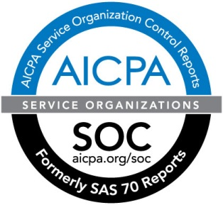
Built on a Trusted and Secure Platform
On-demand and Multi-tenant
Redundant architecture
Geographically load balanced
Logical/physical security
Disaster recovery
Automatic backups
Certifications and standards
mobility as a service
Notes:
Fiberlink recognizes that as a trusted provider of security and secure mobility services it must meet high standards of operational security.
FISMA Authority to Operate (ATO)
MaaS360 by Fiberlink went through the C&A process in 2011 to become FISMA certified. MaaS360 was chosen by GSA (General Services Administration) as one of three cloud service providers to go through the certification process this year. The process included an audit showing adherence to the NIST SP800-53R3 guidelines. Fiberlink went a step further and asked the auditors to also include the proposed FedRAMP requirements, which are special additions to the NIST guideline specifically for cloud service providers. In addition to the overall audit, Fiberlink has to give quarterly updates to GSA showing Continuous Monitoring of our systems as well as audits and penetration tests.
SOC-2 Type II
In 2011 the AICPA changed their auditing standards retiring the SAS-70 standard. In its place, Fiberlink has adopted the SOC-2 Type-II audit as the standard going forward. Fiberlink had E&Y perform our first SOC-2 assessment in 2011 with positive results. The SOC-2 audit covers security, availability, processing integrity, confidentiality, and privacy.

Slide 6
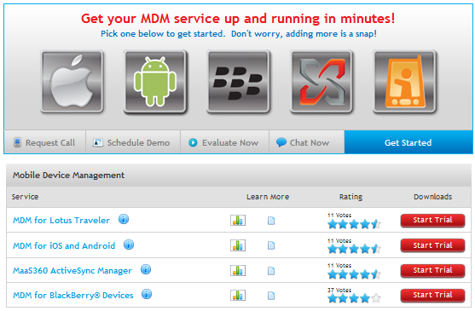
Instant Enterprise Device Management
Agility of the cloud for the pace of change in mobility
Fast deployment
  Simple provisioning processes
  Intuitive user interface
Effortless scalability
  Instantly turn up devices, users, apps
  Start small and easily expand up
Automatic upgrades
  Continuous updates available instantly
  No ongoing maintenance
Unmatched affordability
  Zero infrastructure needed
  All inclusive subscription price model
Notes:
Sparklers:
What is “Instant Enterprise Device Management?”
Simply said….A business…
Truly 5 minutes and there are no strings attached or this isn’t a demo that they gets more complicated when you actually buy the product…
No..No…No
Pricing
We like to refer to ourselves as the "fastest MDM solution out there”
If you have one takeaway today - In a nutshell, it’s easy

Slide 7






Complete Lifecycle Management
Device Enrollment
Mobility Intelligence
OTA Configuration Management
Help Desk Support
Continuous Monitoring & Security
Expense Management
Application & Doc Management
Notes:
MaaS360 enables you to support the entire enterprise mobility lifecycle, from provisioning to configuration management, compliance and security, app and document management, support, expense management, and reporting.

Slide 8
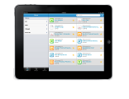




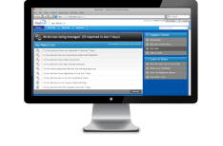









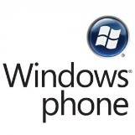



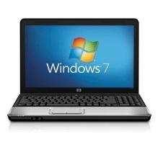
How MaaS360 Works
Management Console
Mobile Device Management
Mobile App Management
Document Management
Mobile Expense Management
Exchange
AD/LDAP
Lotus
BES
Cloud Extender
Certs

Slide 9
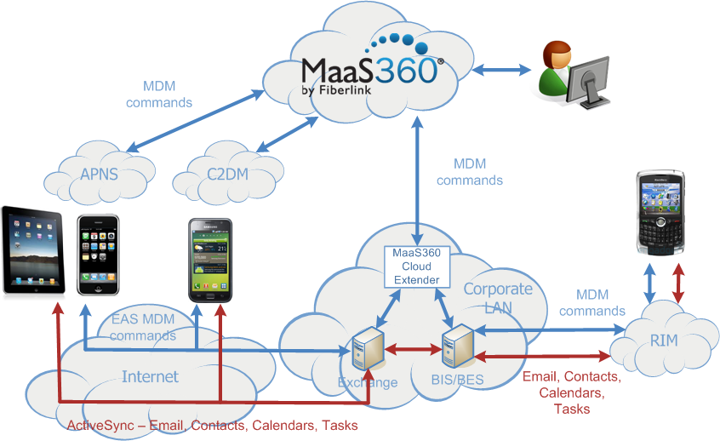
How MaaS360 REALLY works!
Notes:
Here is how MaaS360 really integrates with mobile devices from both an MDM and a messaging perspective.
Email:
The red lines in this diagram indicate the flow of email, contact & calendar data between your messaging server and your employees mobile devices. This is the confidential data that is most important to protect.
Your messaging server should always be configured to use SSL when transferring email to mobile devices. This insures that the data is encrypted in transit to and from the mobile device.
Securing data at rest on the mobile device can easily be accomplished by enabling device-level encryption (supported by all iOS devices and some Android devices) or through the use of a third-party email application that supports encryption (like TouchDown for Android).
Don’t forget about employee satisfaction and productivity. Employees typically prefer to use the native email client that comes with their device. Transporting email through third-party servers and networks not only adds additional security vulnerabilities but these networks can also leave you at risk for an email outage affecting all your mobile users (think recent RIM outages).
Notice that MaaS360 is NEVER in the flow of any email, that means that MaaS360 doesn’t add additional security vulnerabilities and can not impact the productivity of your end users.
MDM:
The blue lines indicate the flow of mobile device management commands and responses between MaaS360 and the mobile devices. Notice that MDM commands can be sent to iOS and Android devices via your companies messaging server (via ActiveSync) or can be sent directly from MaaS360 to iOS and Android devices via Apple’s Push Notification Service (APNS) or Google’s Cloud To Device Messaging (C2DM) service.
It is always better to manage iOS and Android devices via APNS and C2DM than ActiveSync. Both the breadth and sophistication of the management and security features available via APNS and C2DM far surpass what is supported via ActiveSync. Of course, ActiveSync is still available via MaaS360 for managing legacy devices like Windows Mobile and WebOS.
Finally, the BlackBerry is still the mobile device of choice for many organizations. MaaS360 can manage and secure your BlackBerry devices through integration with your BlackBerry Enterprise Server.

Slide 10
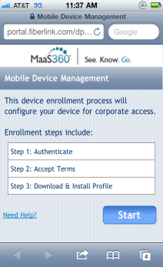
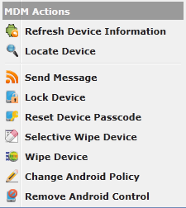
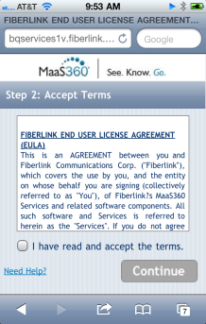

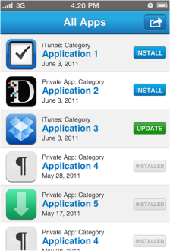
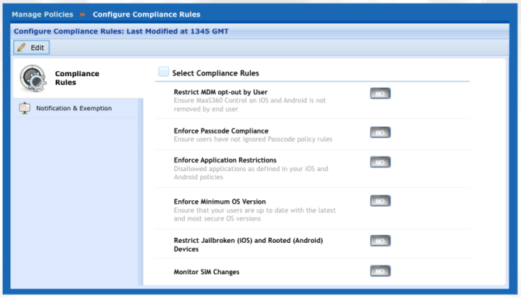
MaaS360 for Mobile Device Management
The Essentials
Device enrollment
OTA configuration
Security policy management
Real-time reporting
Remote lock & wipe
Self-service Portal
Advanced Management
Email Access Controls
Corporate Directory Integration
Certificate Management
Profile Lock-down
Application and Document Management
Event-based Security and Compliance Rules Engine
Device Enrollment, Acceptable Use
MDM Actions
Corp App Storefront
MaaS360 Event-based Security & Compliance
10
Notes:
Customers we speak with are usually looking for basic security and management right off the bat. These are the must have abilities. Like being able to remotely locate and wipe a lost or stolen device. The ability to understand if a device is rooted / jailbroken. Even having the ability to manage Wi-Fi profiles. Having the ability and tool for real-time deployment, reporting and actions.
(Mention some others from the list)
Then, the desire to implement more advanced management capabilities comes into play. This includes the ability to deploy applications, distribute documents to your sales force or other groups, even create rules which govern the device. A common rule we hear about is setting up restrictions if a user has installed an application which is not authorized by IT. For an iOS device, there is no actually way to force the user to uninstall the application. Using our rules based engine, you can automatically message the user to remove the application. If they do not, their corporate access is taken away.
MaaS360 allows for the progression of features in a seamless fashion. Providing what you need now and allowing you to be prepared for the next generation of support. (Application storefront is a good example of this)

Slide 11
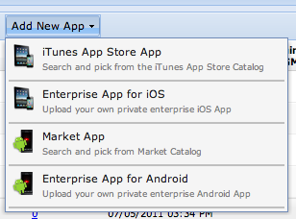

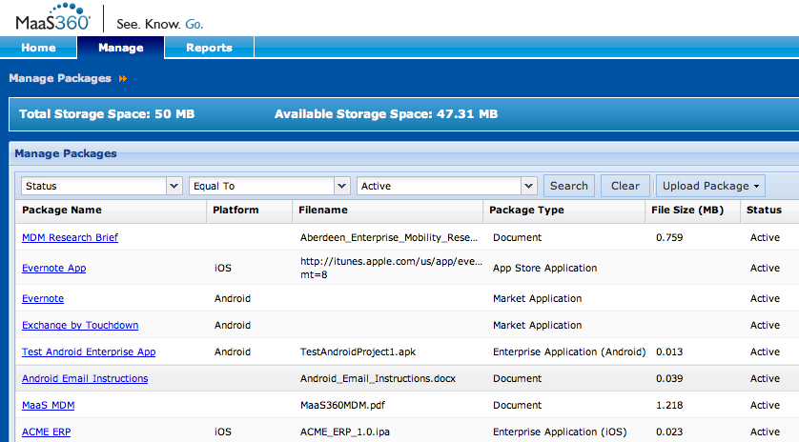

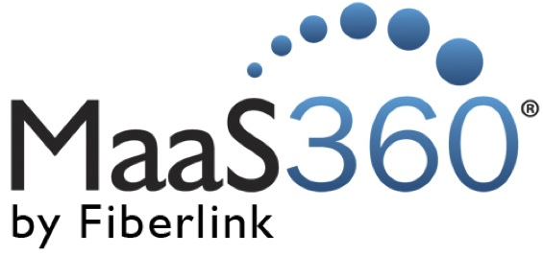
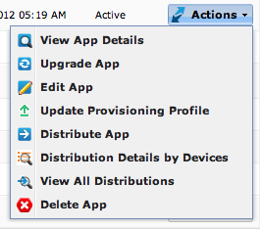
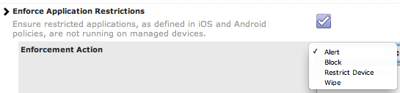
MaaS360 for Application Management
✓
Management Console for App Catalog and Distributions
✓
End-user App Catalog
✓
App Download Authentication & Authorization
App Distribution
Cloud Developer API and Software Development Kit (SDK)
✓
✓
App Lifecycle Mgmt
✓
✓
App Compliance Mgmt

Slide 12



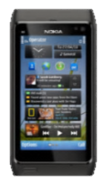
Mobile Device Management Features
Apple iOS
Android
BlackBerry
Windows Phone Symbian and webOS
Activate iOS MDM
Apple certificate-based
Easy device enrollment
Push from admin
User self service enrollment
In-depth OTA configuration and policy management
Passcode, restrictions,
Wi-Fi, VPN, email, and more
Increased actions
Full/selective wipe, lock, update, passcode reset, locate, and send msg
Corporate app storefront
Jail broken device detection
Market agent
In-depth OTA configuration and policy management
Touchdown integration
  Passcode, mandatory or disallowed apps, device feature restrictions, Wi-Fi and email profiles, selective wipe
Increased actions
  Lock, full wipe, update, locate, query, send message, Passcode reset
  Corporate app storefront
  Rooted device detection
Auto-discovery of devices
Auto-discovery of policies
Device Activation
Visibility into device inventory
Increased actions
  Send message
  Reset passcode
  Change BES policy
  Wipe Device
  Remove device from BES
  Refresh data
Support for Blackberry Enterprise Server 5.0 and higher
Exchange or Lotus Notes
Supports all EAS or Traveler connected devices
Prevents non-approved devices from accessing corp. email
Auto-discovery of devices
Auto-quarantine of devices
Alerts and workflows to Approve or Block devices
Create and enforce ActiveSync policies (e.g., PIN)
Remote device wipe
Support for Exchange 2007 & 2010, and Office 365
Support for Traveler 8.5.2+
Notes:
Here is a quick breakdown of the advanced features we offer by Operating System. Please keep in mind that we can provide management of any device which leverages ActiveSync or Lotus Traveler. This includes Windows mobile, Windows 7 Phone, Symbian, and even WebOS.

Slide 13
Thank You
13

