Slide 1
Endpoint Security for the Cloud Generation
<Presenter Name>
<title>
Date:

Slide 2
Agenda
Endpoint Security Overview (3-6)
SEP 14 & SEP Cloud Awards & 3rd Party Testing Results (91-98)
Endpoint Security – What’s New (7- 23)
SEP EDR Awards & 3rd Party Testing Results (98-99)
Why Symantec - User Stories & Product Details (24 – 60)
What to Do Next? (61 – 64)
Notes:
This deck includes all of the SEP Family products and it laid out so that you can chose the stories you want to share with your customers.

Slide 3





Evolving Threat Landscape
Hard to keep up with significant growth and sophistication in cyber threats
1,000,000
Per DAY
new malware variants detected on the endpoints in 2016
55%
36%
7.1B
18.4M
Increase in
targeted attacks
Increase of ransomware in 2016
  Identities exposed in data breaches in the last 8 years
  Mobile malware infections blocked by Symantec
Source: Symantec ISTR Report 2017
Notes:
Traditional security approaches to protect users and data are no longer adequate to address an evolving threat landscape that includes ransomware, stealthy attacks and malware targeting mobile devices. In fact, research has found that threats dwell in a customer’s environment an average of 190 days¹.
The latest Internet Security Threat Report (ISTR) shows an enormous number of malware variants being detected every day. Attackers continuously adapt to organizations’ defenses by creating new variants of malware designed to evade network and endpoint security.
In just the last year, we saw more than one million new malware variants introduced per day and the number of ransomware families tripled. An estimated 76% of websites that Symantec scanned had vulnerabilities that could be exploited by attackers to serve malware.
In 2016, Symantec blocked 18.4 million mobile malware infections. 1 in 20 devices will have experienced an attempted infection in 2016.
Well over half al all organizations were hit by some sort of ransomware attack last year.
Internet Security Threat Report, 2016

Slide 4

Endpoint Security Challenges / Chaos
SHORTAGE OF SECURITY PERSONNEL
MOBILE MALWARE
AV
VENDOR
RANSOM-WARE
EDR
VENDOR
STEALTHY ATTACKS
WEB
VENDOR
EVOLVING THREATS LANDSCAPE
ROAMING
USERS
POINT PRODUCTS = DISJOINTED SECURITY
BYOD
TARGETED
THREATS
EMAIL
VENDOR
Ownership Form-factor Location
VULNERABLE MOBILE WORKFORCE
OPERATIONAL COMPLEXITY
4
Notes:
In the wake of the disruption that the cloud and ‘bring your own device’ (BYOD) trends created, vendors emerged offering a myriad of point products all attempting to solve a portion of the security problem. Enterprises now face a set of disjointed products that require costly custom integrations and require high management overhead. With shortages of trained IT security personnel and increased operational complexity, the mobile workforce is more vulnerable than ever before.

Slide 5



What is Cloud Generation Endpoint Security?
Cloud | Datacenter | Web | Email | Open APIs | Telemetry | Analytics | Orchestration | Automation
INTEGRATED CYBER DEFENSE
MULTILAYERED – DEFENSE-IN-DEPTH, DETECTION & RESPONSE, ADAPTIVE
ENDPOINT AGNOSTIC
Corporate / BYOD
Traditional / Modern
SINGLE AGENT
HQ Branch-office Roaming
OPERATIONAL EFFICIENCY
Scalable Global Deployment
Hybrid Management
Notes:
- The Symantec approach provides a complete endpoint security solution that secures the Enterprise and its mobile workforce across traditional and modern OS devices over any network and from any location.
- Multiple layers of endpoint security technologies result in industry-leading efficacy against emerging threats.
- And the Symantec endpoint is integrated into a larger cyber defense platform covering web and email security, threat analytics, security orchestration and automation.
- Symantec's single agent architecture and hybrid management capabilities support operational efficiency and a lower total cost of ownership.

Slide 6








Cloud Generation Endpoint Security Portfolio
SEP Family Provides the Most Complete Endpoint Security in the Industry
Security Stack
Headquarters Data Center
SEP
SEP Mobile
GIN
Analytics
Sandbox
Cloud Proxy
Branch
Office
SEP
SEP Mobile
Symantec Endpoint Protection 14
Symantec Endpoint Protection Mobile
Symantec Endpoint Detection and Response
Symantec Endpoint Protection Cloud
Roaming
Users
Personal Devices
Notes:
Skycure allows us to extend advanced endpoint security to mobile devices.

Slide 7






SEP Security Framework
PREVENTION
DETECTION
ADAPTATION
RESPONSE
DECEPTION
SINGLE
AGENT

Slide 8


SEP Security Framework
SEP 14 or
SEP Cloud:
ADAPTATION
PREVENTION
DETECTION
RESPONSE
DECEPTION
DISCOVER
SINGLE
AGENT
BLOCK
REMEDIATE
REPORT
Notes:
- Symantec Endpoint Protection (SEP) 14 delivers superior, multi-layer protection to stop threats regardless of how they attack your endpoints.
- SEP provides advanced ransomware protection by combining artificial intelligence techniques such as advanced machine learning (AML) technologies, behavior analysis with proven technologies like intrusion prevention.
- Signature-less exploit prevention technology in SEP 14 prevents vulnerabilities in popular software like browsers and productivity tools from being exploited.
- An easy-to-use workflow allows customers to fine-tune AML, behavior analysis and intrusion prevention to gain advanced visibility into suspicious files and customize protection to suit different environmental needs.
- A low-bandwidth mode protects network constrained environments with the same superior efficacy.

Slide 9







SEP: Most complete protection in the industry
65% Better Security Efficacy
Stop Targeted Attacks and Zero-Day Threats with layered protection
Patented real-time cloud lookup for scanning of suspicious files
Enhanced
Enhanced
Enhanced
Enhanced
NETWORK FIREWALL & INTRUSION PREVENTION
DEVICE CONTROL & SYSTEM LOCKDOWN
MEMORY EXPLOIT MITIGATION
REPUTATION ANALYSIS
ADVANCED MACHINE LEARNING
EMULATOR
BEHAVIOR MONITORING
NETWORK FIREWALL & INTRUSION PREVENTION
Blocks malware before it spreads to your machine
and controls traffic
Control file, registry, and device access and behavior; whitelisting, blacklisting, etc.
Blocks zero-day exploits against vulnerabilities in popular software
Determines safety of files and websites using the wisdom of the community
Pre-execution detection of new and evolving threats
Virtual machine detects malware hidden using custom packers
Monitors and blocks files that exhibit suspicious behaviors
Blocks malware before it spreads to your machine
and controls traffic
INCURSION
INFECTION
INFESTATION & EXFILTRATION
Notes:
Updated for SEP 14.1
MEM – Adds 9 new techniques
AML – Now supported on Mac and can block malicious scripts before they run.
Reputation – Now includes BlueCoat GIN that provides new insights on IP and URL reputation
Behavior Monitoring – Includes better ransomware protection as well as protection against malicious script executions.

Slide 10




SEP: Most complete protection in the industry
Patented real-time cloud lookup for scanning of suspicious files
Enhanced
POWER ERASER
HOST INTEGRITY
SECURE WEB GATEWAY INTEGRATION
SEP EDR
(ATP 3.0)
Aggressive remediation of hard-to-remove pre-existing infections
Quarantine, detect unauthorized change, conduct damage assessment and ensures compliance
Use APIs to orchestrate a response from Secure Web Gateway
Full endpoint activity recording and playback. Real-time IOC hunting, correlation and response.
REMEDIATE
Notes:
SEP EDR - Now has full endpoint capture (EAR – Endpoint Activity Recording) as well as real time search, hunt and remediate
Threat Insights – (coming soon) will provide new insights into active persistent threats in the environment
SEP Hardening – Provides visibility into unknown untrusted apps and vulnerable trusted apps on the endpoint with controls to isolate and protect them,

Slide 11

SEP Product Offerings
Same Multi-Layered Advanced Protection
Machine Learning, Behavior Analysis, Exploit Prevention, Global Intelligence Network
SEP 14
Advanced endpoint security solution with hybrid management
that combines Protection, Detection & Response, Deception and Hardening in a single agent and with granular management
SEP Cloud
Advanced protection for users and all their devices including mobile, with fully cloud managed and always up-to-date security that is easy to use and set up in under 5 minutes
Advanced capabilities: Tunable protection, built-in deception and EDR, Application Isolation and Control add-on, Host Integrity, Mobile Threat Defense (add-on)
Integrated Cyber Defense: Built-in integrations with web and email gateways and Open APIs for integrations with other vendors
Advanced capabilities: Cloud EDR add-on, Mobile Security and Device Management, Encryption add-on, Mobile Threat Defense (add-on), Partner Management Console
Integrated Cyber Defense: Built-in integrations with identity management, and Open APIs for integrations with other vendors
Notes:
Symantec Endpoint Protection Cloud (SEP Cloud) is an easy to use security-as-a-service that provides the same enterprise grade efficacy as SEP 14 to protect and manage PC, Mac, mobile devices and servers from a single cloud console, making it the ideal solution for organizations with limited IT security resources. SEP Cloud effectively stops today’s ransomware, zero-day threats and other sophisticated attacks using advanced multi-layered technologies including advanced machine learning and behavior analysis. Using SEP Cloud’s built-in default security settings and self-service device enrollment capabilities, this solution quickly protects your endpoints.

Slide 12



SEP 14.1 Overview
NEW
USE CASE #1
USE CASE #2
USE CASE #3
Grey Activity Detection
Intensive Protection & Control
Low Bandwidth Mode
  “I want to detect suspicious activity in my environment without the need to deploy additional endpoint agents”
“I want to fine-tune my endpoint security by security group to improve my security posture”
  “I want to protect endpoints in low connectivity environments with the same efficacy”
Gain Visibility into Grey Activity. Tune Protection by Asset Value. Control Content Update Frequency
Notes:
Grey Activity Detection – SEP goes beyond determining if a file is good or bad to include details and risk scoring for suspicious files.
By Intensive Protection and Control - easily adjusting the blocking and monitoring sliders, security teams can tune the level of aggressiveness to meet their specific needs for each group of endpoints
Low Bandwidth Mode – For environments with minimal access or bandwidth, including POS systems use this configuration for once a week content updates.

Slide 13


SEP Security Framework
EDR:
PREVENTION
EXPOSE
DETECTION
ADAPTATION
RESPONSE
DECEPTION
1
2
3
PRIORITIZE
SINGLE
AGENT
INVESTIGATE
HUNT
CONTAIN
RESOLVE

Slide 14


Symantec Endpoint Detection
& Response Overview
Symantec EDR exposes, contains and resolves breaches resulting from advanced attacks
GIN
SANDBOX
CORRELATION
Headquarters Data Center
Branch
Office
Roaming Users &
Mac, Linux Endpoints
Headquarters Data Center
Branch
Office
EDR with SEP (ATP: Endpoint)
EDR Cloud
Leverage SEP footprint
Full Endpoint Activity Recording
Correlation across Endpoint, Network and Email
Extend EDR to non-SEP endpoints
Point-in-time Scanning
Rule-based automation of best practices
Notes:
- Sophisticated attackers are increasingly using “living off the land” tactics; one key indicator of this trend is the surge in PowerShell threats.
- A recent Symantec study found that 94.5 percent of PowerShell scripts analyzed were malicious².
- Symantec Endpoint Detection and Response solutions (EDR) gives investigators the tools to expose, contain and resolve breaches resulting from advanced attacks.
- Symantec supports endpoint detection and response for devices with SEP and on endpoints without SEP.

Slide 15



Symantec EDR – ATP: Endpoint Overview
NEW
USE CASE #1
USE CASE #2
USE CASE #3
Beta
Endpoint Activity Recorder
File-less Detections
Hybrid Sandbox
“I need continuous visibility and
real-time queries across endpoints to see threat-related impacts”
“I need to detect and get alerted to threats that ‘hide in plain sight’ like PowerShell executions and memory exploits“
  “I want the flexibility to sandbox and detonate suspicious objects
  on-premises or in the cloud”
Integrated EDR with SEP for incident response and remediation.
Notes:
Symantec Advanced Threat Protection: Endpoint is the EDR solution integrated with SEP and can be ready-to use within an hour.
It exposes advanced attacks with precision machine learning and global threat intelligence minimizing false positives and helps ensure high levels of productivity for security teams.
ATP: Endpoint’s EDR capabilities allow incident responders to quickly search, identify and contain all impacted endpoints while investigating threats using a choice of on-premises and cloud-based sandboxing.
In addition, continuous recording of system activity supports full endpoint visibility and real-time queries. ATP: Endpoint utilizes behavior analytics to detect file-less attacks such as memory based and malicious power shell execution.
Use case #1
Records critical system activity including file operations, registry key changes, process activity, load point changes and user login and logoff
- Search EDR database and endpoints directly
Incident investigators can quickly filter for specific attributes, identify uncommon values and pivot to relevant entity page
Use case #2
- View PowerShell processes, rules-based detection identifies and creates incidents for suspicious scripts
- Memory Exploits blocked by Symantec Endpoint Protection will automatically generate incidents for investigator to analyze for associated artifacts
Use case #3
- Detonate suspicious files using cloud-based or on-premises sandboxing
- Cloud sandbox supports physical and virtual suspicious file awareness
- Leverage file reputation, network traffic analysis and global telemetry (GIN)

Slide 16



Symantec EDR Cloud Overview
NEW
USE CASE #1
USE CASE #2
USE CASE #3
Detection
Automation
Visualization
“I want to examine my endpoint estate as a whole to find outliers that don’t belong in the environment.”
“I want to leverage the skills of experienced investigators and ease the task of artifact collection”
  “I need better visualization tools to simplify the analysis of complex of cyber data”
Symantec EDR Cloud delivers incident response for non-SEP environments.
Notes:
Symantec Endpoint Detection and Response (EDR) Cloud is a unique solution that delivers in-depth threat visibility and breach response across the entire enterprise.
Symantec EDR Cloud enhances investigator productivity with automated incident playbook rules and user behavior analytics that brings the skills and best practices of the most experienced security analysts to any organization, resulting in significantly lower costs.
Use case #1
Detect software, memory, user and network outliers that stand out from baseline activity
Use timeline and path analysis to detect multi-phased attacks
Expose memory-based attacks with analysis of process memory
Use case #2
Replicate the best practices and analysis of skilled investigators with automated incident playbook rules
Gain in-depth visibility into endpoint activity with automated artifact collection
Initiate cyber security functions and learn expert investigation methods with built-in playbooks
Use case #3
- Understand the contextual relationship between unrelated data types with visual link analysis
Use graphical alerts to quickly learn the source, timing, and impact of an incident
Transform voluminous endpoint telemetry into interactive graphics to focus on relevant activity

Slide 17
SEP Security Framework
PREVENTION
DETECTION
ADAPTATION
SEP Deception:
ADAPTATION
RESPONSE
DECEPTION
RESPONSE
DECEPTION
DEPLOY
DECEPTORS
SINGLE
AGENT
MONITOR
ALERT
ANALYZE
Notes:
SEP Deception is an endpoint-based deception solution included with SEP 14 that reveals attacker intent and tactics via early visibility, so that the information can be used to enhance security posture.
Symantec is the only endpoint protection platform vendor offering deception, and SEP Deception features the most accurate and insightful detection while delivering the fastest time to value.
Joint Symantec Endpoint Protection and Symantec Managed Security Services customers benefit from 24x7 real-time SEP Deception monitoring and response by a global team of experts.

Slide 18




SEP Deception
NEW
USE CASE #1
USE CASE #2
USE CASE #3
Expose Hidden
Adversaries
Generate High
Fidelity Alerts
Deploy
At Scale
“I want to uncover hidden attackers by creating a minefield against their tactics, techniques and procedures”
“I want to customize deceptors to my environment in order to generate high confidence alerts and reduce false positives”
“I want to rapidly deploy deceptors across my enterprise by leveraging the SEP agents already running on my endpoints”
Deceive attackers. Reveal their intent. Improve security posture.
Notes:
Expose Hidden Adversaries – Find the attackers who are lurking on the endpoints (again, averaging 191 days before detection)
Generate High Fidelity Alerts – Security staff is already too busy, need to be confident that alerts mean what they say, so that the security team is not chasing false positives. Also, need alerts that provide detail to what the attacker is doing and trying to do.
Deploy at Scale – Security teams do not want another point product to deploy. For Symantec, Deception is included with SEP 14, so the agents are already installed for current customers. Just configure and deploy.

Slide 19


SEP Security Framework
SEP Hardening:
PREVENTION
Risk Insight:
DETECTION
ADAPTATION
RESPONSE
DECEPTION
VISUALIZE
ANALYZE
SINGLE
AGENT
ANALYZE
ISOLATE
1
2
3
BENCHMARK
HARDEN
Notes:
SEP Hardening is an advanced application defense solution that delivers comprehensive protection for applications by isolating suspicious apps and shielding trusted ones like browsers. In fact, on average, there were 2.4 browser vulnerabilities discovered per day in 2016 ². Unlike point products from other application isolation vendors, SEP Hardening uses the same agent as SEP deliver unprecedented efficacy against malware and suspicious applications. In addition, SEP Hardening maintains high employee productivity by fully supporting standard employee workflows.
Symantec Risk Insight is an easy to read cloud delivered threat analytics dashboard that assesses security posture across an Organization’s environment, customers, supply chain and brand. It provides visibility and trends for key metrics, including malware analysis, targeted attacks, infection rate, mean time to remediate and more. Risk Insight collects telemetry from local sources including Symantec Endpoint Protection and the Global Intelligence Network to provide granular industry and regional benchmarks. The cloud-based architecture and use of local telemetry to measure enterprise risk, eliminates the cost and complexity of hardware or installing new agents.

Slide 20




SEP Hardening Overview
NEW
USE CASE #1
USE CASE #2
USE CASE #3
010101010101010101010101010101101010101010
Assess & Classify Every App
Defend Known-good Apps
Isolate Suspicious Apps
“I want to know what applications are running in my environment. For each app, I want to know how much risk I’m taking on based its vulnerabilities, reputation, source and behavior”
  “I want to prevent and arrest zero day attacks from compromising trusted applications and gaining privileged system control”
  “I want to allow end users to safely download applications without risk of infection. Unsafe applications should automatically run in isolation mode”
1 Click Isolation: Browsers (IE, Chrome, Firefox); Office Apps (Word, Excel, Powerpoint); Adobe Apps (Acrobat)
Notes:
Assess & Auto-classify Every App – find every app running, installed or not, and get a risk/vulnerability assessment for each
Defend Known-good Apps – shield commonly used apps so that vulnerabilities within that software cannot be used to attack the endpoint or network. Prevent malicious activity form originating from these applications.
Isolate Suspicious Apps – isolate these apps and prevent them from any privileged operations (e.g. downloading other software, making changes to the system/registry, etc.)

Slide 21

Symantec Risk Insight Overview
USE CASE #1
USE CASE #2
USE CASE #3
An Enterprise Risk Dashboard
Designed for CISOs and Executives
Brings Data to Security Operations
Cloud-based security analytics application
Analyzes your enterprise attack and defense data and our global threat intelligence to provide a true view of risk
  Distills complex data down to the most critical information
  Summary views to communicate investment ROI to the executive team and business priorities to operations.
  Comprehensive, granular, and actionable insights
  Intuitive data drill-downs for exploration and analysis

Slide 22
SEP Mobile Overview
USE CASE #1
USE CASE #2
USE CASE #3
Malicious Apps
Unpatched Vulnerabilities
Risky Wi-Fi Networks
“I don’t have protection against malware on my mobile devices”
  “I don’t have visibility into vulnerabilities affecting mobile OS/applications”
  “I am worried about my users connecting to suspicious Wi-Fi networks”
Defend against malicious apps. Ensure devices are properly patched. Protect from network-based attacks.

Slide 23
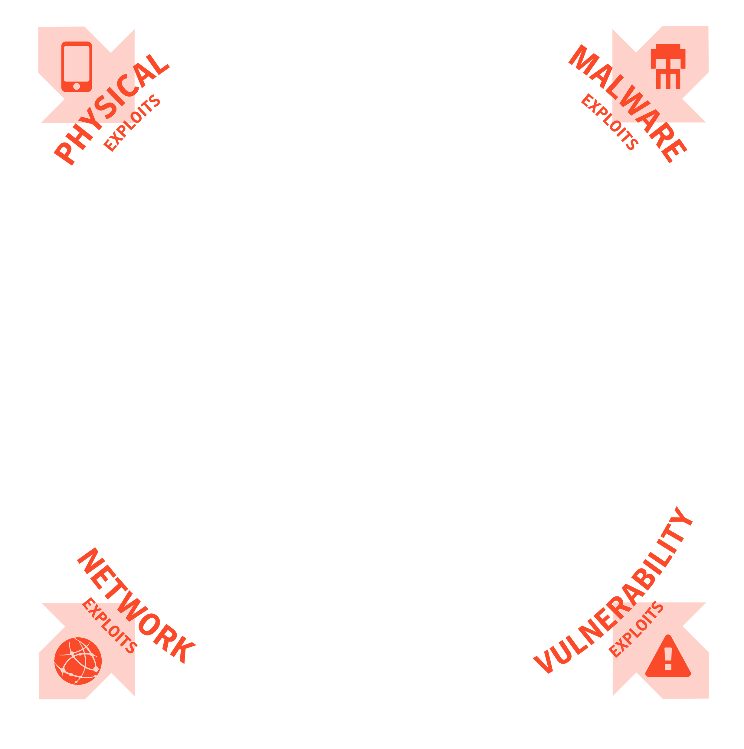

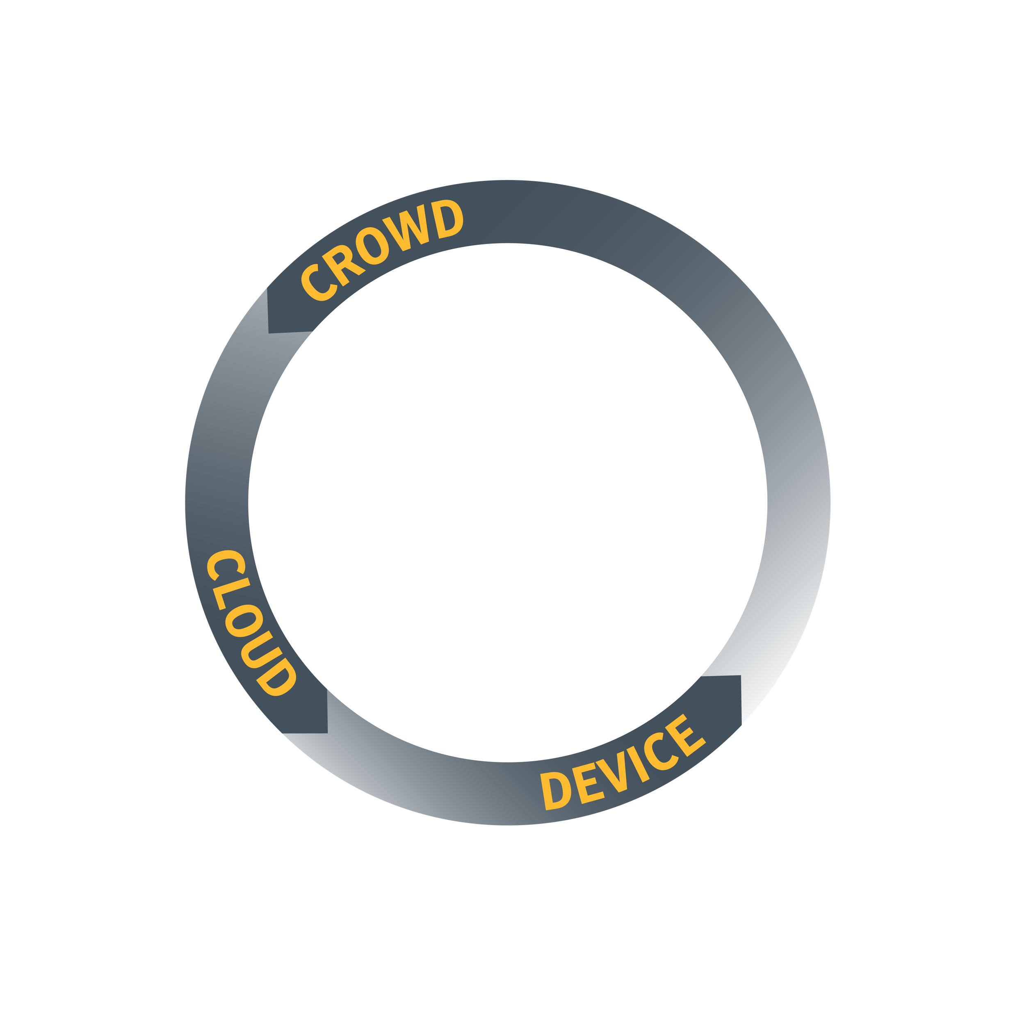
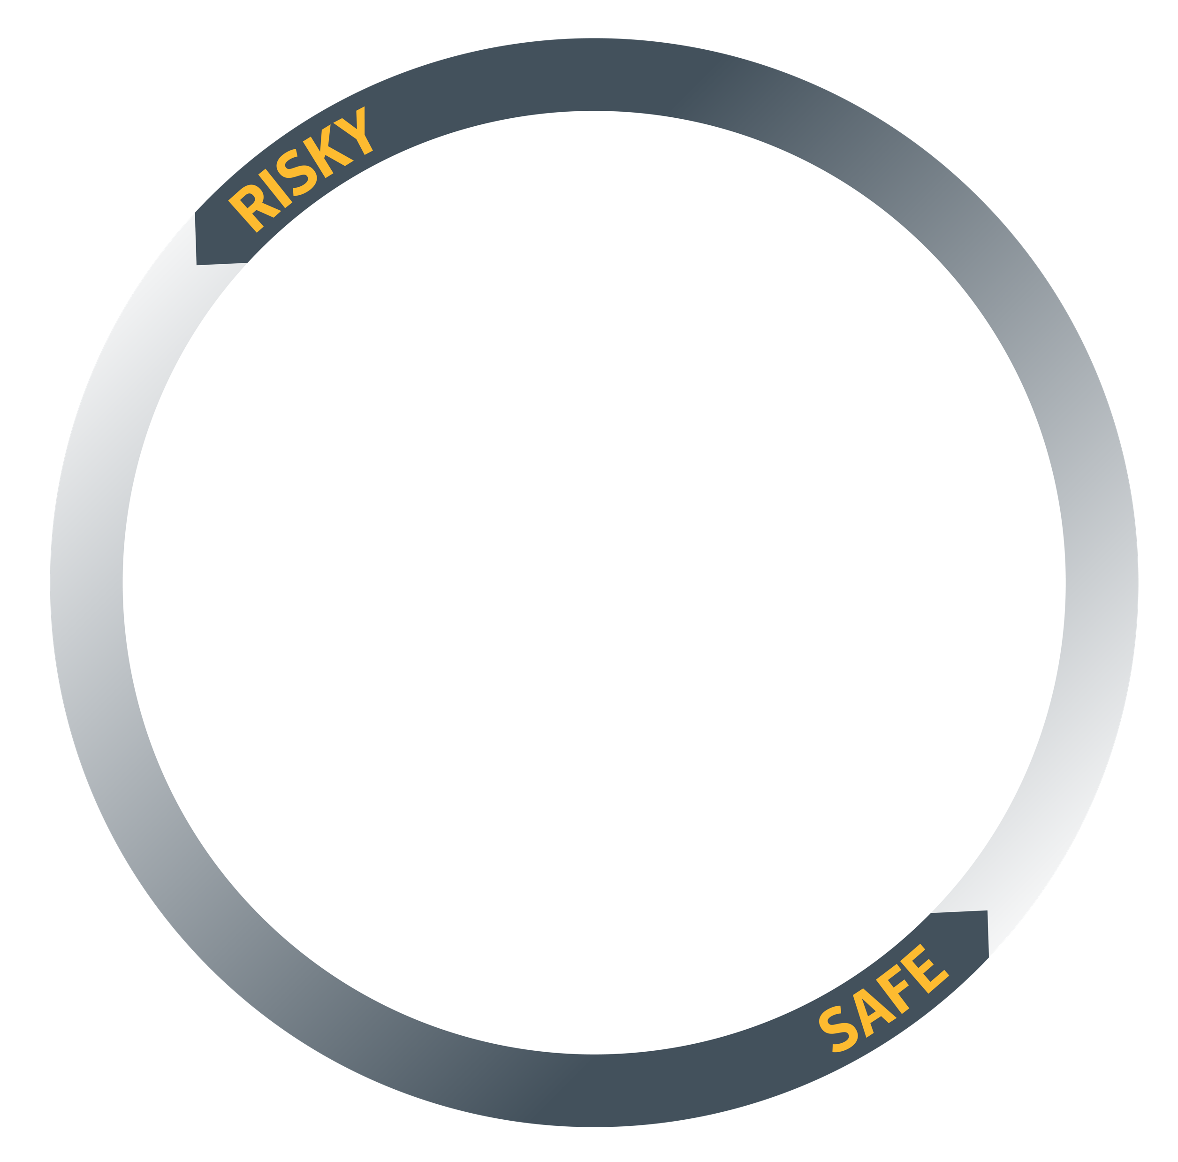

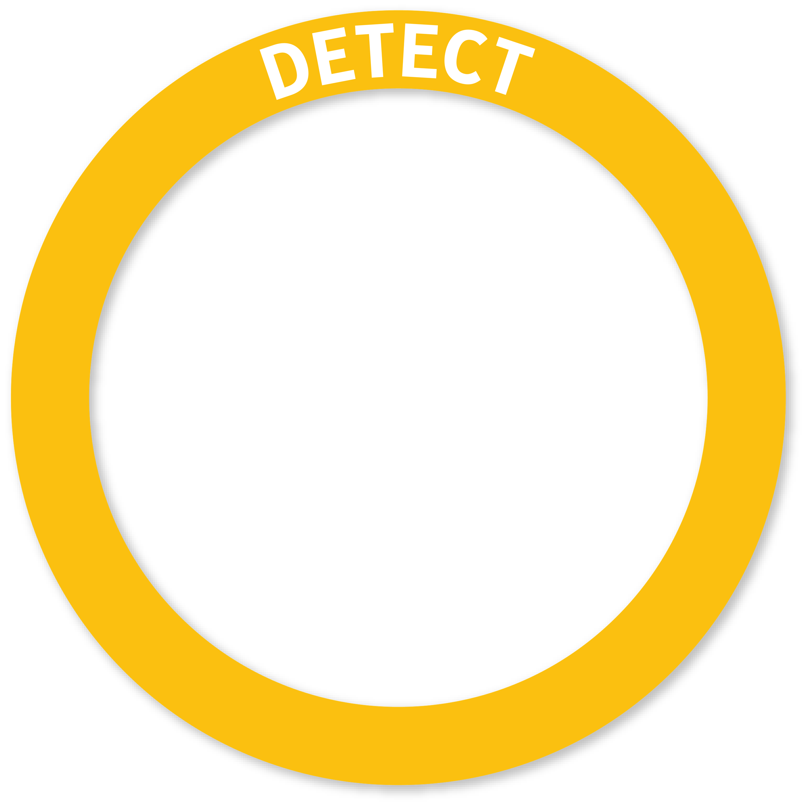



SEP Mobile Security Framework
Threat Intelligence
SEP Mobile crowd-wisdom
Integrated Global Intelligence Network
1000 Cyber Warriors. 175 M Endpoints. 8 B Daily Security Requests.
EMM
EMM
Cloud Server
Risk/compliance visibility
Advanced security
Automation & integration
Consistent
across Managed
& Unmanaged
scenarios
Public App
Simple deployment & maintenance
Ensured privacy
Minimal footprint
Symantec’s Layered Mobile Security
Notes:
SEP Mobile collects threat intelligence from multiple sources:
SEP Mobile research team and install base for mobile security specific intel
Symantec Global Intelligence Network that has more than 1000 cyber warriors from around 9 SOCs around the world, analyzing data from 175M endpoints and responding to more than 8 billion daily security requests
Third party sources
This helps us provide industry’s unparalleled threat intelligence for all endpoints – traditional and modern.

Slide 24
Why Symantec?

Slide 25















SEP Family
Provides
Complete
Endpoint
Security with a Single Agent
SEP HARDENING
SEP 14.1
Application Isolation & Control
Anti-Malware
Deception
SEP 14.1
SEP DECEPTION
Advanced Malware Protection
Mobile Threat Defense
Endpoint Detection & Response
SEP MOBILE
SYMANTEC EDR

Slide 26
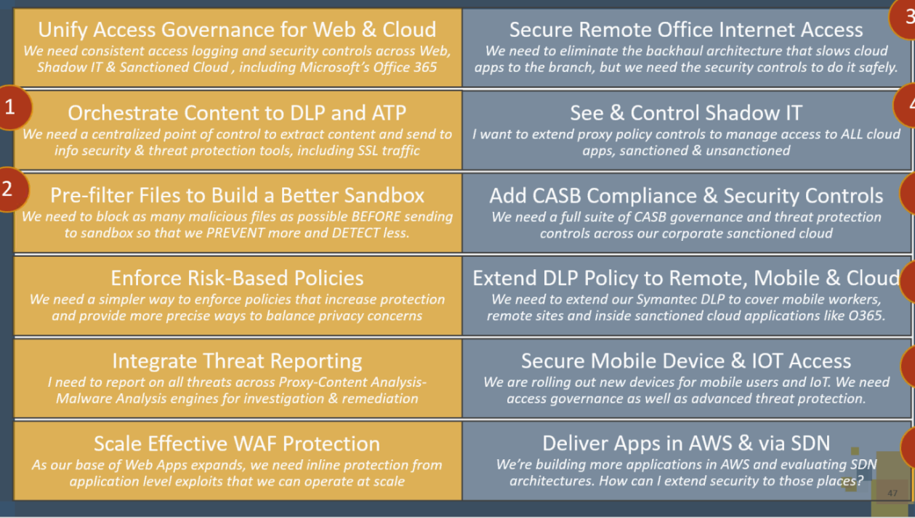
Endpoint Security User Stories
User Stories
SEP 14 FAMILY
ENDPOINT DETECTION AND RESPONSE
Protect against Emerging Threats
Optimize Security by Fine-Tuning Protection
Detect Anomalies, Investigate Suspicious Events and Fix Impacted Endpoints
Reduce Cost and Complexity
Conduct Endpoint Investigations with Continuous Recoding and Playback
Endpoint with Integrated Cyber Defense
Extend EDR to non-SEP, Roaming Users, macOS and Linux Devices
SEP Deception
Improve Security Posture by Determining Attacker Intent
Awards, customer testimonials, 3rd party validations
SEP Hardening
Protect against Threats Executed via Applications
SEP MOBILE
Symantec Risk Insight
Assess, Monitor and Benchmark Risk
SEP Mobile Overview
SEP CLOUD
Protect Against Malicious Mobile Apps
Protect firms with limited IT security resources
Defend Against Unsafe Wi-Fi Networks
Reduce Costs and Complexity for Branch Office Security
Reduce Risk From Unpatched Vulnerabilities
Awards, customer testimonials, 3rd party validations
Awards, customer testimonials, 3rd party validations

Slide 27
Protect against Emerging Threats
LIST
(ENDPOINT)
LIST (USER)
Why Symantec?
NEED
“I need better security efficacy at my endpoints against emerging threats”
Advanced machine learning powered by the largest civilian intelligence network (GIN - 175M endpoints strong)
Effectiveness against ransomware like WannaCry and Petya
CHALLENGE
  Sophisticated malware and zero-day exploits continue to threaten endpoint defenses
PRODUCT
  Symantec Endpoint Protection 14
  Symantec Endpoint Protection Cloud
CAPABILITIES
  Advanced Machine learning
  Memory Exploit Mitigation
  Global intelligence Network
  Behavior Monitoring
  Intrusion Prevention
  Reputation Analysis
27

Slide 28

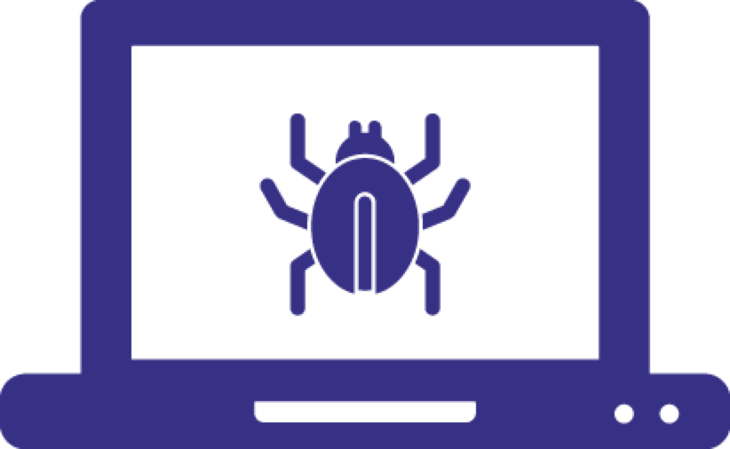

Customer Challenges
Enterprise perimeter is disappearing leading to blind spots
(cloud, roaming users, etc.)
Endpoints have large attack surface; sophisticated attacks cannot be stopped by a single protection technology
Deploying security technologies result in many standalone vendors with disjointed point products require more resources
Security staff spend a lot of time firefighting
Notes:
With end users requiring access to corporate resources in the office, at home, or on the road, IT security teams need to enable safe ad secure productivity anywhere and at anytime.

Slide 29
SEP: Most complete protection in the industry
Stop Targeted Attacks and Zero-Day Threats with layered protection
Patented real-time cloud lookup for scanning of suspicious files
Enhanced
Enhanced
Enhanced
Enhanced
NETWORK FIREWALL & INTRUSION PREVENTION
DEVICE CONTROL & SYSTEM LOCKDOWN
MEMORY EXPLOIT MITIGATION
REPUTATION ANALYSIS
ADVANCED MACHINE LEARNING
EMULATOR
BEHAVIOR MONITORING
NETWORK FIREWALL & INTRUSION PREVENTION
Blocks malware before it spreads to your machine
and controls traffic
Control file, registry, and device access and behavior; whitelisting, blacklisting, etc.
Blocks zero-day exploits against vulnerabilities in popular software
Determines safety of files and websites using the wisdom of the community
Pre-execution detection of new and evolving threats
Virtual machine detects malware hidden using custom packers
Monitors and blocks files that exhibit suspicious behaviors
Blocks malware before it spreads to your machine
and controls traffic
INCURSION
INFECTION
INFESTATION & EXFILTRATION
Notes:
Updated for SEP 14.1
MEM – Adds 9 new techniques
AML – Now supported on Mac and can block malicious scripts before they run.
Reputation – Now includes BlueCoat GIN that provides new insights on IP and URL reputation
Behavior Monitoring – Includes better ransomware protection as well as protection against malicious script executions.

Slide 30
SEP: Most complete protection in the industry
Patented real-time cloud lookup for scanning of suspicious files
Enhanced
POWER ERASER
HOST INTEGRITY
SECURE WEB GATEWAY INTEGRATION
SEP EDR
(ATP 3.0)
Aggressive remediation of hard-to-remove pre-existing infections
Quarantine, detect unauthorized change, conduct damage assessment and ensures compliance
Use APIs to orchestrate a response from Secure Web Gateway
Full endpoint activity recording and playback. Real-time IOC hunting, correlation and response.
REMEDIATE
Notes:
SEP EDR - Now has full endpoint capture (EAR – Endpoint Activity Recording) as well as real time search, hunt and remediate
Threat Insights – (coming soon) will provide new insights into active persistent threats in the environment
SEP Hardening – Provides visibility into unknown untrusted apps and vulnerable trusted apps on the endpoint with controls to isolate and protect them,

Slide 31

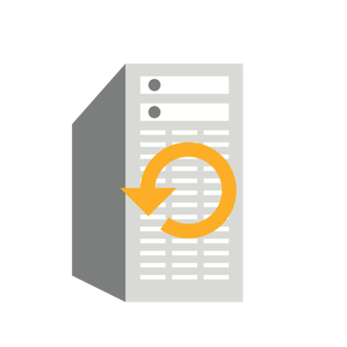

Advanced Machine Learning
Blocks unknown threats and mutating malware
Collect Training sets
in Real-Time
0-day protection against variants of the same malware family
Training Algorithm
Detects large classes
of malware with a
low false positive rate
Trained Machine
New & Retrained
Advanced ML
High efficacy with infrequent updates
Detect on client
with Advanced
Machine Learning
Notes:
SEP 14 introduces new Advanced Machine Learning, which works on the endpoint, something emerging competitors tout highly, and in the cloud. It compliments what we already have with Reputation and Behavioral Analysis.
Advanced Machine Learning is most useful for detecting unknown threats or evolving threat families. For example, if a variant of known malware surfaces, advanced machine learning is generally smart enough to detect it for zero-day protection. On the attack chain it works during the early part of infection, to stop threats before they have a chance to execution.
It uses the power and scale of a real time cloud-based machine learning engine to detect large classes of malware generically with a very low False Positive rate.
The quality of the dataset that machine learning is trained with determines the effectiveness the technology. Symantec machine learning is trained using the largest civilian global threat intelligence network in the global with big data analysis , and a team of security analysts. Other vendor’s machine learning cannot achieve that richness of data and size of dataset. How big is it?

Slide 32
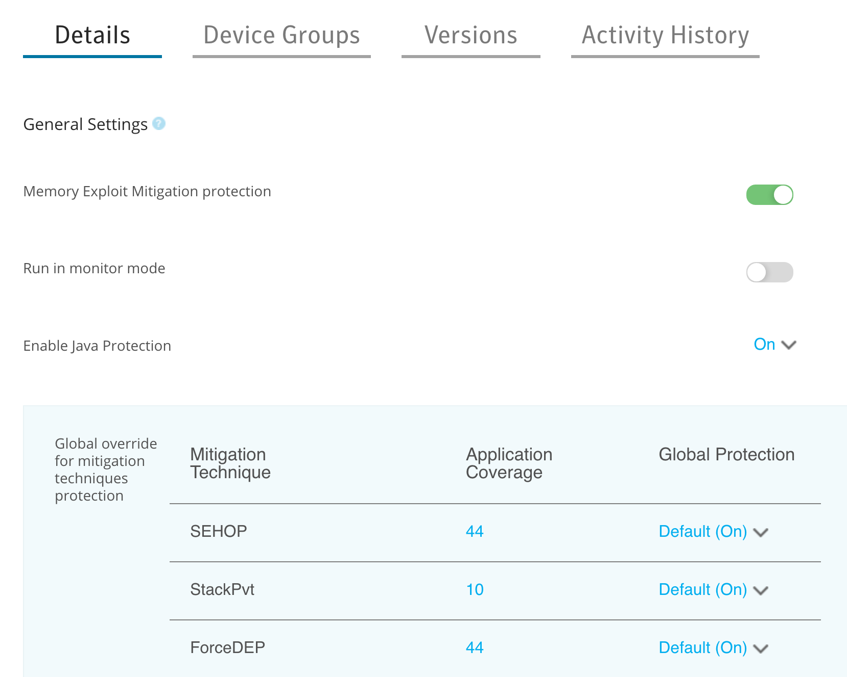









Memory Exploit Mitigation
Blocks zero day memory attacks in popular software
Preemptively blocks attacker exploit techniques
Works without signatures or knowledge of the vulnerability
Log-only mode supports testing individual techniques for individual applications
Vulnerability Discovered
Vulnerability Discovered
Patch
Released
Patch
Applied
WEEKS
MONTHS
ZONE OF EXPLOITATION
Notes:
Memory Exploit Mitigation, a key capability we are introducing in SEP14, will significantly reduce the Product’s “time to Protect” in dealing with zero-day Exploits. Many targeted attacks increasingly use zero-day exploits to take advantage of known or recently discovered vulnerabilities in popular software like Internet Explorer, Adobe, or Microsoft Office. Memory Exploit Mitigation is signature-less and hardens the operating system to stop the attack regardless of the flaw, bug, or vulnerability in the software on day 0, instead of waiting for a patch from the vendor then scheduling time to apply the patch – leaving customers vulnerable for several weeks or months.
The Memory Exploit Mitigation techniques added in SEP 14 would have neutralized 80% of the top memory based attacks in the past few years. And more mitigation are planned for future releases.

Slide 33



Behavioral Monitoring
Behavioral monitoring stops zero-day and unknown threats
Artificial Intelligence
Based Classification Engine
Human-authored
Behavioral Signatures
Behavioral Policy
Lockdown
Monitors nearly 1400 file behaviors to answer:
What has it done?
Where did it come from?
What did it contain?
Who is it related to?
Notes:
Behavioral Monitoring (also known as SONAR™) technology monitors nearly 1400 file behavior as they execute in real-time. If any skeptical behavior is found, SONAR will block it automatically. With both Advanced Machine Learning, Insight, and SONAR, Symantec allows customers to protect against new and rapidly mutating malware and to stop zero-day threats without compromising performance or false-positive.
The most advanced zero-day threats require file behavior monitoring only available through SONAR. Symantec’s SONAR uses artificial intelligence, behavior signatures, and policy lockdown to monitor nearly 1400 file behaviors as they execute in real-time. Rather than relying on how a file looks like, SONAR watches what a file does. Having analyzed millions of applications, SONAR quickly determines the behaviors of an application are good or bad. When an executable is launched, SONAR identifies malicious behavior and blocks it in real-time. Malware is stopped before it can run.

Slide 34




File Reputation Analysis
Age, frequency, and location are used to expose unknown threats
Attack Quarantine System
Good safety rating
File is whitelisted
Endpoints
Analysts
Gateways
Honeypots
No safety rating yet
Can be blocked
Global Sensor
Network
Analytics
3rd Party Affiliates
Bad safety rating
File is blocked
Global Data Collection
Big Data Analytics
Warehouse
SYMANTEC THREAT INTELLIGENCE NETWORK
Notes:
Symantec Insight also uses the Global Intelligence Network and reputation security technology that tracks billions of files from millions of systems to put files in context, using their age, frequency, location and more to identify low-risk vs high-risk threats. Based on advanced data mining techniques, Insight seeks out changing encryption and mutating code. Because of the security expertise of our analytics, robust analytics and warehouse of contextual data, Symantec Insight can identify how common or rare a file is, how old it is, its security rating, and how it might be associated with malware. Through context, Insight can identify new or rapidly mutating threats as well as targeted attacks.
Insight separates files at risk from those that are safe, for faster and more accurate malware detection. Insight will boost the detection, performance, and accuracy of Symantec Endpoint Protection

Slide 35



Emulation Capabilities
Fast and accurate detection of hidden malware
NO EMULATION
Emulates file execution to cause threats to reveal themselves
Executable
Malware hides
behind custom
polymorphic
packers
Packer
Packed, not recognized
Emulation Environment
Lightweight solution runs in milliseconds with high efficacy
Executable
EMULATION
Packer
Emulator ‘unpacks’
the malware in a
virtual environment
Unpacking
Emulation Environment
Executable
Payload Recognized
Notes:
Attackers use sophisticated tactics to hide malware, hoping the endpoint protection solution won’t detect it until it’s too late. The new Emulator foils malware’s attempts to evade detection, by using polymorphic custom packers, by unpacking in a virtual environment.
The static data scanner runs each file in a lightweight virtual machine to cause threats to reveal themselves improving our detection rates.
There is no performance over-head, the scan happens in milliseconds as a user opens the file, delivering faster scan time compared to our previous emulator.
The combination of improved scan performance and detection rates result in better overall effectiveness in SEP 14.

Slide 36
Optimize Security by Fine-Tuning Protection
LIST
(ENDPOINT)
LIST (USER)
Why Symantec?
NEED
“I need enhanced visibility into suspicious files in my environment, so that I can fine-tune the protection to meet the distinct requirements of my deployment.”
Visibility into gray activity
Easy tuning via slider controls
Monitoring and blocking can be set at different levels to meet specific environment needs
CHALLENGE
  Need to see more and block more threats
PRODUCT
  Symantec Endpoint Protection 14
CAPABILITIES
  Suspicious activity detection
  Easy tuning via separate sliders for monitoring and blocking
36

Slide 37
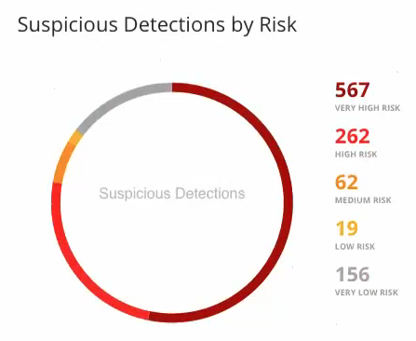
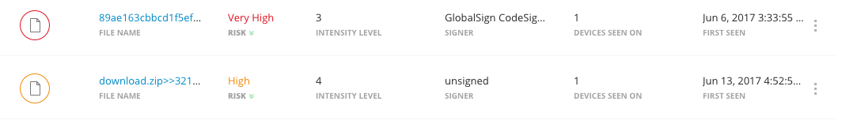
Enhanced Visibility of Suspicious Activity
Discover and address emerging threats
Identify suspicious files detected by Advanced Machine Learning and Behavioral Analysis
Classify files by risk and prioritize remediation
Make informed policy decisions to reduce risk and attack surface
37
Notes:
Grey Activity Detection - Whereas in the past, SEP would determine if a file is good or bad, now it delivers enhanced visibility into suspicious files too, so that the security team can take immediate action in the easy-to-use workflow to properly whitelist and blacklist accordingly.
Use Advanced Machine Learning, Behavioral Analysis, and Reputation Analysis to identify the suspicious files
Classify files by risk and prioritize remediation (including whitelisting and blacklisting)
Make informed policy decisions to reduce risk and attack surface

Slide 38
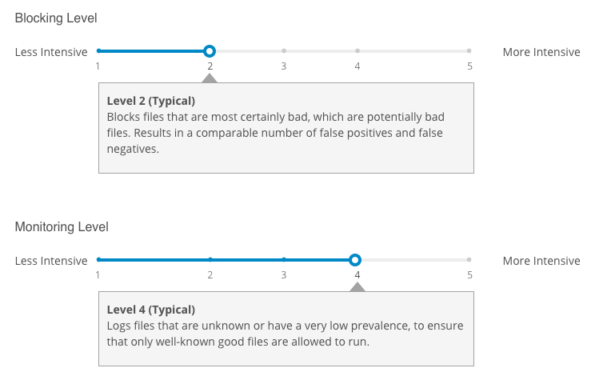
Intensive Protection
Tune machine learning and behavior analysis
Integrated workflow to block more threats
Review suspicious files
Whitelist potential false positives
Blacklist true positives
Set suitable protection (blocking) threshold
Apply to individual groups or globally
38
Notes:
Separate sliders (can be configured at different settings) for blocking and monitoring allow security teams to easily see more and block appropriately.
Integrated workflow to block more threats
Review list of suspicious files
Whitelist potential false positives and blacklist true positives
Set suitable protection (blocking) threshold
Apply to individual groups (of devices) or globally

Slide 39
SEP 14.1 Protection: Efficacy At Different Levels
Internal Testing of SEP 14.1 with Malware Samples
+40%
+29%
+19%
Up to 40% more detections compared to SEP 14 (Level 2)
Blocking Level
Detection Level
Notes:
SEP 14 default is at level 2 for blocking; opportunity to block and see more in 14.1 up to level 5

Slide 40
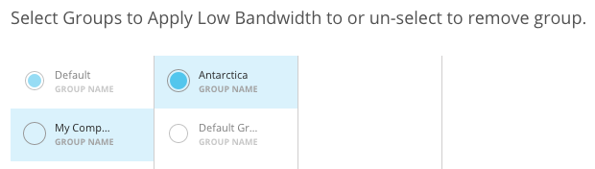

Low Bandwidth Mode
Reduce required updates by relying on machine learning
Designed for sites with low bandwidth
Reduces frequency of updates from 3x daily to 1x weekly
Advanced Machine Learning on the endpoint ensures excellent protection without frequent updates
Apply to specific groups of devices
40
Notes:
Even with less frequent updates, security teams can maintain the same security efficacy by turning up the protections on the blocking and monitoring sliders.

Slide 41
Reducing Cost & Complexity
LIST
(ENDPOINT)
LIST (USER)
Why Symantec?
NEED
“I need to reduce endpoint costs and complexity.”
Single agent for the entire security framework: prevention, detection & response, deception, and adaptation
Improved performance and reduced network bandwidth requirements
CHALLENGE
  Dealing with multiple point products, agents, and vendors is time and resource-consuming
  Limited IT budget and resources with an increasingly complex IT environment
PRODUCT
  Symantec Endpoint Protection 14
CAPABILITIES
  Single agent for multilayered protection
  29% reduction in network bandwidth usage (from SEP 14 to SEP 14.1)
  Less impact on end users
41

Slide 42
Reducing Total Cost of Ownership and Complexity
SEP HARDENING
SEP 14.1
Application Isolation & Control
Anti-Malware
Deception
SEP 14.1
SEP DECEPTION
Advanced Malware Protection
Mobile Threat Defense
Endpoint Detection & Response
SEP MOBILE
SYMANTEC EDR

Slide 43





Preserving End User Productivity
Lighter network bandwidth consumption and less end user impact
Intelligent Threat Cloud
Most up-to-date cloud intelligence to scan suspicious files
70% size reduction in network bandwidth usage (from SEP 12 to SEP 14.1)
Low Bandwidth Mode
Reduce content updates to only once a week
Easily tune machine learning, behavior analysis and reputation analysis to maintain security efficacy
43
Notes:
SEP 14 helps address performance issues that could result in Help Desk calls with new Intelligent Threat Cloud. To do so we now have Intelligent Threat Cloud. It uses patented real-time cloud lookup, which delivers faster scanning times with advanced design techniques, like pipelining , trust propagation, and batched queries to provide the most up to date protection. What happens if we can’t connect to the cloud? We have a fairly definitive verdict already at the endpoint, so if we can’t corroborate it, we convict it. The fact that we can quickly lookup signatures in the cloud means that we don’t need to keep all the definitions on the endpoint, so definition file updates can focus on the newest threat information. This reduces the frequency and size, of our signature definition files, which in turn lowers network usage and increases performance.
In addition, low bandwidth mode reduces content updates to once a week for minimal impact to end user and endpoints without sacrificing security efficacy.

Slide 44
Endpoint with Integrated Cyber Defense
LIST
(ENDPOINT)
LIST (USER)
Why Symantec?
NEED
“I want to leverage my investments more fully.”
Breadth of security portfolio
Integration with web, email, EDR, content analysis and more
Integration with SIEM, threat analytics, and telemetry
APIs for automation and orchestration
CHALLENGE
  Multiple point products and technologies are not integrated well for security automation or joint response
PRODUCT
  Symantec Endpoint Protection 14
CAPABILITIES
  Symantec integrations
  APIs for partner and third-party integrations
44

Slide 45
Endpoint with
Integrated
Cyber Defense
WEB
THREAT ANALYTICS
EMAIL
SIEM
ENDPOINT +
NETWORK
ANALYTICS
+ VISIBILITY
CLOUD GENERATION ENDPOINT
PUBLIC APIs +
ORCHESTRATED RESPONSE
SANDBOX
TELEMETRY
TICKETING
AUTOMATION
SECURITY
ORCH.

Slide 46








Orchestrated Response
SEP + Network Security Integrations
ROAMING USERS:
ENDPOINT + WSS
GLOBAL INTELLIGENCE NETWORK
PROXYSG
SEP MANAGER
HQ
MESSAGING
GATEWAY
CONTENT ANALYSIS
SEP AGENT
Branch Offices
Verify, blacklist and remediate directly from SWG/SMG on the endpoint
Re-direct web traffic from roaming users to WSS to ensure same protection as on-premise
Single agent on client
INTERNAL MESSAGING SERVER
Notes:
SEP 14 integrates with Symantec Content Analysis to provide rapid endpoint remediation of malicious content that originated from Symantec Messaging Gateway and ProxySG channels. With a single click, you can blacklist and delete malware on SEP endpoints. Finally, Symantec’s Global Intelligence Network is updated with the IOC information.
SEP/WSS integration
Blocks targeted attacks using advanced detection technologies
- static, dynamic & behavior analysis
Provides rich threat intelligence including key malicious indicators, event timeline & threat risk score
Complete Cyber Defense Platform protects mail, web & endpoint channels
Rapid Remediation: Perform single-click remediation (blacklist, delete malware) of threats on endpoints

Slide 47
EDR with SEP – Detect Anomalies, Investigate Suspicious Events and Fix Impacted Endpoints
LIST (USER)
LIST
(ENDPOINT)
NEED
  “I have to shorten the window of exposure when a threat slips through, contain the incident and quickly fix any compromised endpoints”
Why Symantec?
Add EDR without additional endpoint agent
Risk-scored events, streamed in real-time
Expose and investigate threats leveraging the world’s largest intelligence network
Quickly fix compromised endpoints, with one click
CHALLENGE
  Although SEP is blocking the majority of threats, attackers can still find their way in.
PRODUCT
  Symantec EDR solution (ATP: Endpoint)
CAPABILITIES
  Hybrid sandboxing and detonation
  Real-time search for any attack artifact
  Remediate all attack artifacts across the estate
47

Slide 48


Customer Challenges
Endpoints remain easy targets and have a large attack surface
44%
of customers were compromised despite using malware blocking technologies
38%
  of time spent by security professionals in firefighting alerts
46%
  of organizations cite a ‘problematic shortage’ of cyber security skills, demand expected to grow 53% by 2018
27%
  the likelihood of a recurring material data breach over the next two years, $3.62 M average total cost of a data breach in 2016
Source: Symantec ISTR Report 2017 vol. 21,22, Gartner MQ for EPP 2016 , ESG Endpoint Paradox 2016, ESG Research 2016, Ponemon Data Breach Study

Slide 49
Symantec Endpoint Detection and Response – ATP: Endpoint
USE CASE #1
USE CASE #2
USE CASE #3
Preview
Endpoint Activity Recorder
File-less Detections
Hybrid Sandbox
“I need continuous visibility and
real-time queries across endpoints to see what changes threats made to endpoints”
“I need to detect and get alerted to threats that ‘hide in plain sight’ like PowerShell executions and memory exploits“
  “I want the flexibility to sandbox and detonate suspicious objects
  on-premises or in the cloud”
Integrated EDR with SEP for incident response and remediation.
Notes:
Symantec Advanced Threat Protection: Endpoint is the EDR solution integrated with SEP and can be ready-to use within an hour.
It exposes advanced attacks with precision machine learning and global threat intelligence minimizing false positives and helps ensure high levels of productivity for security teams.
ATP: Endpoint’s EDR capabilities allow incident responders to quickly search, identify and contain all impacted endpoints while investigating threats using a choice of on-premises and cloud-based sandboxing.
In addition, continuous recording of system activity supports full endpoint visibility and real-time queries. ATP: Endpoint utilizes behavior analytics to detect file-less attacks such as memory based and malicious power shell execution.
Use case #1
Records critical system activity including file operations, registry key changes, process activity, load point changes and user login and logoff
- Search EDR database and endpoints directly
Incident investigators can quickly filter for specific attributes, identify uncommon values and pivot to relevant entity page
Use case #2
- View PowerShell processes, rules-based detection identifies and creates incidents for suspicious scripts
- Memory Exploits blocked by Symantec Endpoint Protection will automatically generate incidents for investigator to analyze for associated artifacts
Use case #3
- Detonate suspicious files using cloud-based or on-premises sandboxing
- Cloud sandbox supports physical and virtual suspicious file awareness
- Leverage file reputation, network traffic analysis and global telemetry (GIN)

Slide 50







Symantec Endpoint Detection & Response –
ATP: Endpoint
Provide incident investigation and response, using SEP agent
Detect and Investigate suspicious events
Hunt for Indicators of Compromise
Global Intelligence
Hybrid Sandbox
Correlation
ATP Console
Record all events and get complete visibility with incident playback
ATP: Endpoint
Appliance
Fix impacted endpoints, with one click
SEP Manager
No new endpoint agent required
Notes:
This is the high level overview of our EDR value proposition and architecture.
Architecture:
ATP:EP is part of the broader ATP solution- One of the3 ATP modules that also includes ATP: Network, and Email
The ATP Endpoint module leverages SEP to collect all the endpoint events.
These events get sent to the ATP appliance where we do sandboxing, payload detonation, and correlation.
Today, ATP can be delivered by a physical or a virtual appliance.
Value Prop:
Detect, Expose and investigate suspicious events. Hunt for Indicators-Of-Compromise
Fix endpoints and and associated artifacts of an attack in minutes, as simple as clicking a single button
Does not require a new endpoint agent to be deployed

Slide 51



EDR with SEP: Identify Incidents from Real-Time Streaming Events
Provide me with smart incident alerts so I know where to spend my time
SEARCHABLE EVENT ACTIVITY
Event Type | Event Description
Session | User session logon and logoff
Process | Launch and terminate
Module | Loads and unloads
File | Create, Read, Delete, Rename
Folder | Folder operations
Registry Key | Operations on registry key
Registry Value | Operations on registry values
Network | Actor process network
Named object | Named object attributes
Process Injections
!
Processes Spawned in
a System Folder from
Non-System ID
Load Point Modifications
RISK-SCORED STREAMING EVENTS
ON DEMAND EVENT RETRIEVAL
Notes:
Investigators can take advantage of Endpoint Activity Recording to hunt for Indicators of Attack and perform endpoint analysis. ATP: Endpoint supports on-demand retrieval for a wide range of events including session, process, module load point modifications, file and folder operations, registry changes and network connection activity.

Slide 52
EDR with SEP – Conduct Endpoint Investigations with Continuous Recoding and Playback
LIST
(ENDPOINT)
LIST (USER)
Why Symantec?
NEED
  “I need to quickly investigate an attack and understand every change and action performed in historical sequence.”
Full historic visibility of endpoint activity
Real-time search of database and endpoint
Filters enhance investigator productivity
Quickly fix compromised endpoints, with one click
Add EDR without additional endpoint agent
CHALLENGE
  In event of a compromise , I need to know every system and process change made to endpoints.
PRODUCT
  Symantec EDR solution (ATP: Endpoint)
CAPABILITIES
  Direct communications with SEP agent
  Search database or endpoints directly for any artifact
  Filters for attributes, events, key pair least popular values and pivot to entity page
52

Slide 53
Customer Challenges
Endpoints remain easy targets and have a large attack surface
44%
of customers were compromised despite using malware blocking technologies
38%
  of time spent by security professionals in firefighting alerts
46%
  of organizations cite a ‘problematic shortage’ of cyber security skills, demand expected to grow 53% by 2018
27%
  the likelihood of a recurring material data breach over the next two years, $3.62 M average total cost of a data breach in 2016
Source: Symantec ISTR Report 2017 vol. 21,22, Gartner MQ for EPP 2016 , ESG Endpoint Paradox 2016, ESG Research 2016, Ponemon Data Breach Study

Slide 54

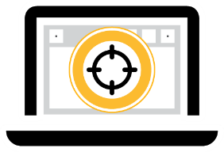

Endpoint Recording and Playback
See system and process changes threats made to endpoints
Endpoint
Activity Recorder
What happened on my endpoints?
Which files were used and where did they come form?
Did malware spread to other endpoints?
What process has been changed on my endpoints?
Request data
1
2
3
4
5
Continuous recording over time
Retrieve and playback everything available on the local queue
Notes:
Endpoint Activity Recorder would allow customers to conduct endpoint forensic analysis. It serves as a DVR that records everything happening on their endpoint.
Customers can retrieve everything on the local queue, including all files and registry I/O, network connections, and more*.
With EDR, Symantec provides answers to all these questions, such as…
What happened on my endpoints?
Which files were used and where did they come form?
Did malware spread to other endpoints?
What process has been changed on my endpoints?
*All file and registry I/O, network connections, mutex (lock) and process events, and service registration events on the machine

Slide 55
EDR Cloud – Extend EDR to Non-SEP, macOS, Linux, and Roaming Users
LIST
(ENDPOINT)
LIST (USER)
NEED
  “I need to conduct investigations on non-SEP, roaming endpoints, macOS and Linux devices”
Why Symantec?
Extend investigations to endpoints where agents are not deployed
Assess the security posture for the entire endpoint estate
Discover outliers that don’t belong in your environment
Lower costs with built-in playbooks and encapsulate best practices
CHALLENGE
  Need visibility and forensics analysis for endpoints where where an agent is not deployed.
PRODUCT
  Symantec EDR Cloud
CAPABILITIES
  Point-in-time scanning across endpoints
  Rule-based automation of investigator best practices
  Visualization tools give security analysts insight into contextual relationships
55

Slide 56
Customer Challenges
Endpoints remain easy targets and have a large attack surface
44%
of customers were compromised despite using malware blocking technologies
38%
  of time spent by security professionals in firefighting alerts
46%
  of organizations cite a ‘problematic shortage’ of cyber security skills, demand expected to grow 53% by 2018
27%
  the likelihood of a recurring material data breach over the next two years, $3.62 M average total cost of a data breach in 2016
Source: Symantec ISTR Report 2017 vol. 21,22, Gartner MQ for EPP 2016 , ESG Endpoint Paradox 2016, ESG Research 2016, Ponemon Data Breach Study

Slide 57
Symantec EDR Cloud Overview
USE CASE #1
USE CASE #2
USE CASE #3
Detection
Automation
Visualization
“I want to examine my endpoint estate as a whole to find outliers that don’t belong in the environment.
“I want to leverage the skills of experienced investigators and ease the task of artifact collection”
  “I need better visualization tools to simplify the analysis of complex of cyber data”
Symantec EDR Cloud delivers incident response for non-SEP environments.
Notes:
Symantec Endpoint Detection and Response (EDR) Cloud is a unique solution that delivers in-depth threat visibility and breach response across the entire enterprise.
Symantec EDR Cloud enhances investigator productivity with automated incident playbook rules and user behavior analytics that brings the skills and best practices of the most experienced security analysts to any organization, resulting in significantly lower costs.
Use case #1
Detect software, memory, user and network outliers that stand out from baseline activity
Use timeline and path analysis to detect multi-phased attacks
Expose memory-based attacks with analysis of process memory
Use case #2
Replicate the best practices and analysis of skilled investigators with automated incident playbook rules
Gain in-depth visibility into endpoint activity with automated artifact collection
Initiate cyber security functions and learn expert investigation methods with built-in playbooks
Use case #3
- Understand the contextual relationship between unrelated data types with visual link analysis
Use graphical alerts to quickly learn the source, timing, and impact of an incident
Transform voluminous endpoint telemetry into interactive graphics to focus on relevant activity

Slide 58
Multilayered Detection
Examine the estate as a whole to find anomalies or outliers
DETECTION CAPABILITIES
Detect outliers that stand out from baseline activity
Apply multiple intelligence feeds for file, IP and domain reputation
Use timeline and path analysis to detect irregular file installs and uncommon program execution locations
Multiple threat engines (proprietary and third-party)
Neural network based machine learning using millions of good and bad files
DETECT OUTLIERS ACROSS SOFTWARE, MEMORY, USER AND NETWORK
Software – Expose endpoints that have uncommon software, build discrepancies, unpatched or old operating system releases
Memory – Detect memory-resident outliers using forensic examination of process memory, file and OS object, and system settings
User – User behavior analytics detect attackers acting as legitimate users performing unusual activity
Network – Leverage statistical analysis to identify anomalous IP addresses, reputation lookups identify IP address and domains
Notes:
Symantec EDR Cloud simplifies the hunt for attackers within the environment by providing an across the board view of software, memory, user, and network baseline activity. When attackers operate in the environment, their malware and user activity stands out as anomalies. Symantec EDR Cloud detects these outliers across the environment including:
- Software outliers – Expose endpoints that have uncommon software, build discrepancies, unpatched or old operating system (OS) releases
- Memory outliers – Detect memory-resident outliers using forensic examination of process memory, file and OS object, and system settings
- User outliers – User behavior analytics detect attackers acting as legitimate users performing unusual activity
- Network outliers – Leverage statistical analysis to identify anomalous IP addresses, reputation lookups identify IP address and domains associated with data exfiltration
In addition, Symantec EDR Cloud includes multiple threat engines which risk score files, users accounts, network connections. Detection capabilities also include:
- Neural network based machine learning using millions of good and bad files
- Customer supplied and third-party threat intelligence sources
- Examination of registry changes and scheduled tasks help expose persistent threats
- Multiple anti-malware engines

Slide 59



Automate Investigation and Artifact Collection
Leverage built-in playbooks, create custom workflows
Built-in Playbooks
Custom Workflows
Artifact Collection
Quickly initiate cyber security functions and leverage expert investigation methods with built-in playbooks.
Automate repetitive manual tasks and create custom investigation flows.
Gain in-depth visibility into endpoint activity with automated artifact collection.
Notes:
Symantec EDR Cloud supports playbooks that automate the complex, multi-step investigation workflows of security analysts. Built-in playbooks quickly expose suspicious behaviors, unknown threats, lateral movement and policy violations. The security team can view the playbooks to learn expert hunting and investigation techniques. In addition, Investigators can create their playbooks to automate best practices and document specific threat hunting scenarios.
Replicates and automates best practices of human security experts
Programmable analytics with logical building blocks
Visualize analytics logic to “show our work” | Not a “black box”
Infinitely extendible
Makes security teams more productive

Slide 60
Visualization
Interactive graphics simplifies complex cyber data
Graphical alerts
  Quickly learn the source, timing and impact of an incident
Visual link analysis
  Understand contextual relationship between unrelated data types with visual link analysis
Transform large amounts of data into interactive graphics
  Focus on relevant activity with
  machine-assisted analysis
  Simplify reporting
Notes:
Traditional cyber systems generate too much data presented in rows and columns and require too much expertise to operate.
Symantec EDR Cloud is visually powerful. The system provides visual link analysis with interactive graphics to transform how security professionals use and relate to computer and network data.
Machine-assisted analysis allows interaction with all the relevant data at scale. Link analysis provides a fast conceptual association of complex relationships between disparate data types

Slide 61
Product Positioning

Slide 62

SEP Product Offerings
Same Multi-Layered Advanced Protection
Machine Learning, Behavior Analysis, Exploit Prevention, Global Intelligence Network
SEP 14
Advanced endpoint security solution with hybrid management
that combines Protection, Detection & Response, Deception and Hardening in a single agent and with granular management
SEP Cloud
Advanced protection for users and all their devices including mobile, with fully cloud managed and always up-to-date security that is easy to use and set up in under 5 minutes
Advanced capabilities: Tunable protection, built-in deception and EDR, Application Isolation and Control add-on, Host Integrity, Mobile Threat Defense (add-on)
Integrated Cyber Defense: Built-in integrations with web and email gateways and Open APIs for integrations with other vendors
Advanced capabilities: Cloud EDR add-on, Mobile Security and Device Management, Encryption add-on, Mobile Threat Defense (add-on), Partner Management Console
Integrated Cyber Defense: Built-in integrations with identity management, and Open APIs for integrations with other vendors
Notes:
Symantec Endpoint Protection Cloud (SEP Cloud) is an easy to use security-as-a-service that provides the same enterprise grade efficacy as SEP 14 to protect and manage PC, Mac, mobile devices and servers from a single cloud console, making it the ideal solution for organizations with limited IT security resources. SEP Cloud effectively stops today’s ransomware, zero-day threats and other sophisticated attacks using advanced multi-layered technologies including advanced machine learning and behavior analysis. Using SEP Cloud’s built-in default security settings and self-service device enrollment capabilities, this solution quickly protects your endpoints.

Slide 63
SEP Target Markets
SEP 14
SEP Cloud
Designed for businesses that desire complete control over their endpoint security
Designed for businesses moving to cloud to reduce IT operational costs
Desire granular control over security policies
Desire simplified policy set-up and administration in exchange for less policy control
Invested in advanced security policies such as application and device control, and host integrity
Replace planned hardware and software upgrades with always up to date service
Cyber security strategy includes integration with Symantec web, email and EDR solutions
Switch from CapEx to OpEx purchasing model with flexible subscription terms
Interest in advanced SEP technologies - Hardening and Deception
Initiative to centralize endpoint security in distributed locations and branch offices

Slide 64
Upsell and Cross-Sell Opportunities
SEP Cloud
SEP 14
SEP Cloud
EDR Cloud
Server
SEP SBE
Will EOL middle of 2018
Encryption
SEP Mobile
SEP 14
ATP 3.0
Endpoint (EDR)
Network
Email
Hardening
Deception
SEP Mobile
EDR Cloud
Notes:
SEP Cloud is licensed either per User (5 devices) or per device (PC & Mac endpoints – no mobile) customers can add on SEP cloud Server and SEP Cloud Encryption
*SEP Hardening is a cloud sku and will likely have limited traction via channel partners –
**SEP Deception – requires partners to sell their consulting services
ATP Email requires that Email Security Cloud is installed prior to adding in ATP Email

Slide 65
What to Do Next

Slide 66
What we ask of you
Get trained on our Integrated Cyber Defense Platform. Get more certifications and move to Platinum for more benefits
  Partner University – easy access to training and resources
Take advantage of Deal Registration, especially Margin Builder in the Small Business segment
  Margin Builder program (portal link) for deals under 1,000 company employees. It’s available to all partners in the program. Watch the video >
  Opportunity Registration for deals greater than $10,000 in size (even on non-standard pricing deals). Watch the video >
Share the Customer Use Cases and supporting materials within your business
  Leverage this deck with your sales teams, SE’s and internal staff.
  Leverage the First Customer Meeting Deck to open discussions and opportunities with your customers
Apply a “cloud-first” approach to solving your customers security problems—can Symantec’s cloud solution work best?
Notes:
KEY POINT:
This is what we ask of you…
Where applicable - Write a FY18 business plan with your Symantec Channel Account Manager
to take advantage of cross-selling and the SMB market

Slide 67

SEP Promotions
SEP Mobile Promotion – for current SEP Customers 50% off MSRP
  SEP Mobile for existing SEP customers buying > =50 seats
  50% promotional discount for 1, 2, and 3 year subscription SKUs for SEP Mobile for existing SEP customers
SEP Switch & Save Promotion – 50% off MSRP
Net New customer incentive - 50% discount on Symantec Advanced Threat Protection for Endpoint (EDR) and Free Symantec Risk Insight until March 31, 2018.
  50% discount for Symantec Advanced Threat Protection: Endpoint applies for 1 year, 2 year or 3 year SKUs
  100% promotional discount for Symantec Risk Insight applies for 1 year SKUs only**See promotional flyer for full details

Slide 68
Where to get more Information
PartnerNet – visit the product pages for
  SEP Product Family - https://www.symantec.com/partners/products/endpoint-protection
  SEP Mobile - https://www.symantec.com/partners/products/endpoint-protection-mobile
  SEP Cloud - https://www.symantec.com/partners/products/endpoint-protection-cloud
Opt-in for Partner Communications and New Product announcements
Partner University for Training and Resources - https://learn-partner.symantec.com/Saba/Web_spf/NA1PRD0127/pages/pagelistview/pgcnt000000000026720

Slide 69
Q&A

Slide 70
Thank you

Slide 71
Appendix
Awards and 3rd Party Testing
  SEP and SEP Cloud 68-74
  SEP EDR 75-76
SEP Hardening Use Cases & Product Details 77-84

Slide 72
SEP 14 and SEP Cloud
Awards, Customer Testimonials and 3rd Party Validations

Slide 73
Effective Protection against Ransomware
#1 Reason why customers are adopting SEP14
WANNACRY:
1 billion+ infections blocked!
PETYA:
ZERO reported infections on SEP 14 endpoints

Slide 74
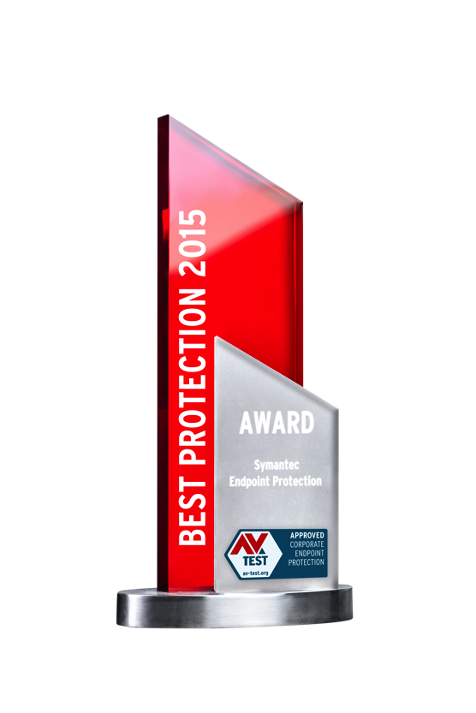

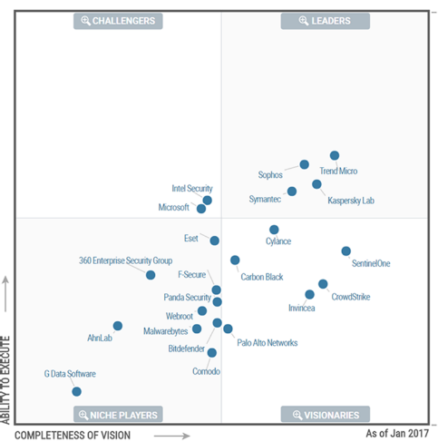
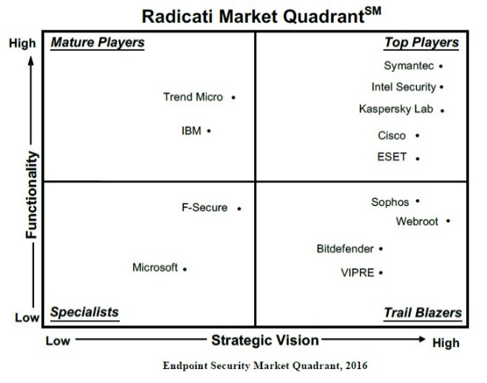

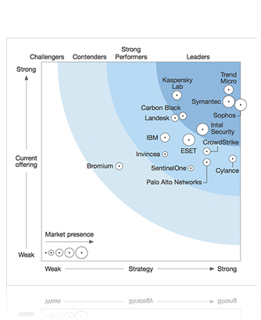
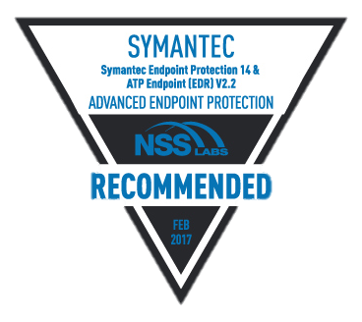


SEP 14 Market Leadership
SEP 14
Recommended Product
Gartner MQ Leader
Winner of AV Test Best Protection 2015 & 2016. ONLY Player to win it twice in a row.
Clear Leader in Functionality & Vision - Radicati Endpoint Security MQ Report
“We love this product.”
15 Years Running
Only vendor with AAA rating for 17 straight quarters
Forrester Leader with highest possible scores in Threat Intelligence, Vulnerability Remediation, Ancillary Endpoint Security Functions.
#1 in EPP market share
(IDC, Nov. 2016)
SEP14 is highly effective with superior protection and performance.
74
Notes:
Industry winners continue to rate SEP as a leader in the endpoint protection space. SEP often wins awards from third parties test labs by consistently providing high levels of protection against advanced threats.

Slide 75



Customer Validation
GOLD WINNER – Gartner Peer Insights Customer Choice Award 2017 –
Endpoint Protection Platforms
Williams Martini Racing
”Symantec Endpoint Protection is brilliant for us.”
Graeme Hackland
Chief Information Officer
Williams Martini Racing
Symantec Endpoint Protection
The Economist
“After implementing Symantec™ Endpoint Protection 14, we achieved some stunning results. We have seen a 60 percent drop in malware events.”
Vicki Gavin
Compliance Director
The Economist
State of Oklahoma
“Consolidating the State of Oklahoma’s spending on IT security solutions and standardizing on Symantec Endpoint Protection will save taxpayers a projected US$2.3 million over five years.”
Mark Gower
Chief Security Officer
State of Oklahoma
75

Slide 76
SEP 14 Outperforms Others
Passmark Enterprise Endpoint Security Performance Test
SEP 14 received the Highest Overall Score in Passmark’s latest performance report
Source: Passmark Enterprise Endpoint Security Performance Report on Windows 7, 2017
Notes:
Passmark is trusted by the industry for providing performance analysis reports on enterprise software. SEP beat its top competitors when Passmark performed 17 different tests. The detailed report is available on SalesCentral and can be distributed to customers.

Slide 77
The Most Effective Product in the Market: AV-TEST
77
Notes:
Real-World Tests:
The most important category where the protective effect of products is concerned is the test against current online threats. This involves accessing known malicious websites or e-mails in order to test whether the protection product is able to ward off attacks.
The fact that this test only uses real current threats means that it perfectly reflects the actual risk situation and threat potential. Given the complexity of the test procedure and the analysis of the results, the quantity of test cases must be limited to a reasonable number. This typically has no influence on the validity of the test because the thousands of different threats present online always only concern variations of a small number of specific malware families.
Prevalence Test:
In order to increase the statistical relevance of the tests, further analyses are carried out with regard to a large number of current threats. This involves decreasing the complexity of the test and in turn increasing the number of test cases many times over. This test refers to the static detection of files, which includes detection with signatures, heuristics and in-the-cloud queries. AV-TEST uses two different test sets to carry out these analyses:
1. All malicious files that were discovered by AV-TEST in the last 4 weeks prior to the beginning of the test, usually around 10,000 to 15,000 files.
2. Extremely widespread malicious files that were discovered by AV-TEST in the last 4 weeks prior to the beginning of the test (detection of widespread malware): around 2,000 to 2,500 files.
Both test sets only use files that have been discovered and analysed by AV-TEST. In order to prevent the test sets from being influenced by the manufacturers in their favour, data from manufacturers are not incorporated into the tests. As a result, the independent analysis carried out by AV-TEST achieves a very high level of quality.

Slide 78
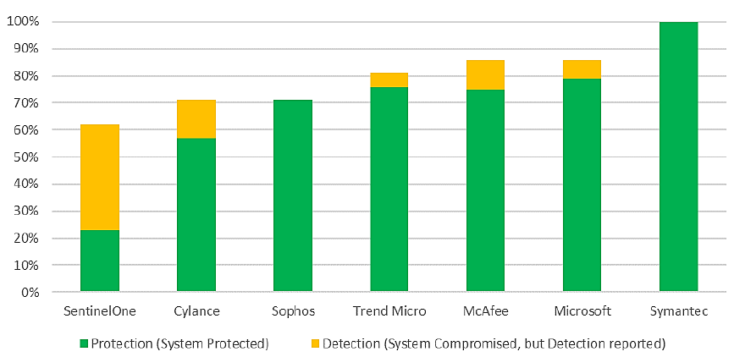

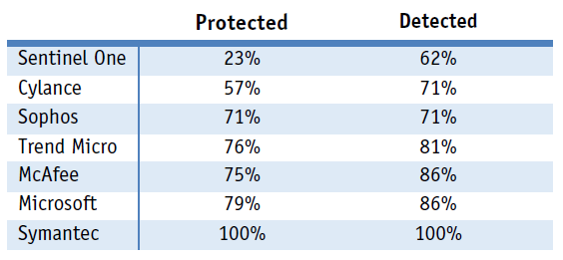
Best Exploit Protection:
AV-Comparatives and MRG Effitas
Symantec Endpoint Protection 14 was the only product that garnered 100% for both protection and detection in the Exploit Protection Test.
Source: AV Comparatives and MRG Effitas October 2016
78
Notes:
In this test, the protection offered by the products were evaluated. The tests were performed from
September till October 2016.
The following tests were performed:
Exploit Test: 21 exploits have been used in the Exploit test.

Slide 79
Endpoint Detection and Response
Awards, Customer Testimonials and 3rd Party Validations

Slide 80
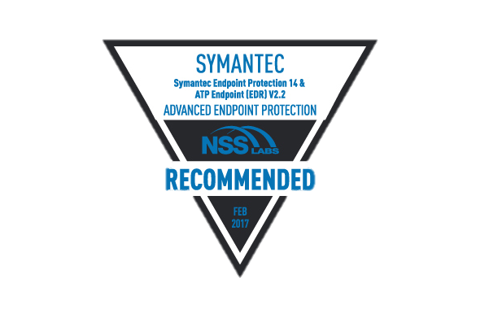




Symantec EDR Market Leadership
Analyst and Lab Validations
GARTNER EDR
COMPETITIVE
LANDSCAPE
IDC STAP
MARKET GUIDE
LEADER 2017
RADICATI APT
PROTECTION MQ
TOP PLAYER 2017
GLOBAL ENDPOINT SECURITY MARKET
FORECAST 2021
NSS LABS RECOMMENED
The endpoint product adds EDR capabilities without new endpoint agents
to deploy
Symantec ATP provides incident responders with complete visibility through a single agent...
“
“
“
Overall leader with clear advantages in current functionality and strategic vision
Symantec leads in EDR market share among EPP providers. Dominates endpoint market share
Symantec
SEP14 + EDR recommended by NSS Labs for Advanced Endpoint Protection
”
”
”
Notes:
RADICATI APT PROTECTION MQ TOP PLAYER 2017
Top Players – These are the current market leaders with products that offer, both breadth and depth of functionality, as well as posses a solid vision for the future. Top Players shape the market with their technology and strategic vision. Vendors don’t become Top Players overnight. Most of the companies in this quadrant were first Specialists or Trail Blazers (some were both). As companies reach this stage, they must fight complacency and continue to innovate.
GARTNER EDR COMPETITIVE LANDSCAPE
The ATP: Endpoint product adds EDR capabilities to SEP without new endpoint agents to deploy. Added on top of SEP, ATP: Endpoint analyzes the endpoint activities monitored by SEP, regardless if they have been blocked.
It reduces the amount of endpoint activity that must be dissected by creating incidents from correlated event data.
NSS LABS RECOMMENED
Security Effectiveness - Symantec Endpoint Protection 14 with ATP Endpoint received an overall Security Effectiveness rating of 98.7%.
Evasions - Symantec Endpoint Protection 14 with ATP Endpoint detected 100.0% of the evasions techniques tested.
False Positives - After the initial tuning, the Symantec Endpoint Protection 14 with ATP Endpoint (EDR) V2.2 did not alert on any false positives during testing.
IDC STAP MARKET GUIDE LEADER 2017
SEP 14 is also tightly integrated with the ATP product, creating comprehensive endpoint threat detection, threat hunting, and rapid incident response and remediation solution set.
GLOBAL ENDPOINT SECURITY MARKET FORECAST 2021
Symantec is the EDR market share leader among EPP vendors (followed by Sophos and Trend Micro)

Slide 81
SEP Hardening – User Case & Product Details

Slide 82
SEP Hardening – Protection against Threats Executed via Applications
LIST
(ENDPOINT)
LIST (USER)
NEED
“I need to protect my endpoints from infections that come in through known good applications without compromising end-user productivity”
CHALLENGE
  To enable end users with the ability to download and use any application safely
PRODUCT
  Symantec Endpoint Protection Hardening
CAPABILITIES
  Discover and classify applications on the endpoint
  Isolate suspicious applications
  Shield commonly used applications from vulnerability exploits

Slide 83

Current Challenges
12+ weeks
average time taken to patch an application vulnerability
Security training is ineffective; 10% median click rate for phishing attacks
Current hardening solutions negatively impact end user productivity
Notes:
12+ weeks to patch an application vulnerability – is too long. Attackers can exploit a vulnerability in that window and cause havoc. Security teams need a faster way to protect their systems.
Security training is ineffective - With a 10% click-through rate for phishing, end users are clearly still clinking where they should not and falling prey to phishing. Compromised credentials are used for attack.
Current hardening solutions negatively impact end user productivity – Solutions today wrap a security envelope around each protected application which bogs down applications and the system. End users need a solution that will not interrupt their work or hamper their productivity.
Lack of visibility into old and vulnerable applications in the environment
Known good applications have become vectors of infection
End users are tricked into downloading malware through increasingly sophisticated spear phishing attacks
Security safeguards often hamper end user productivity

Slide 84
SEP Hardening – Application Isolation
USE CASE #1
USE CASE #2
USE CASE #3
010101010101010101010101010101101010101010
Assess & Auto-classify Every App
Defend Known-good Apps
Isolate Suspicious Apps
“I want to know what applications are running in my environment. I want to know how much risk I’m taking on due to app vulnerabilities”
  “I want to prevent zero day attacks from compromising trusted applications and gaining privileged system control”
  “I want to allow end users to safely download and use applications without risk of infection”
1 Click Isolation: Browsers (IE, Edge, Chrome, Firefox); Office Apps (Word, Excel, PowerPoint); Adobe Apps (Acrobat)
Notes:
Assess & Auto-classify Every App – find every app running, installed or not, and get a risk/vulnerability assessment for each
Defend Known-good Apps – shield commonly used apps so that vulnerabilities within that software cannot be used to attack the endpoint or network. Prevent malicious activity form originating from these applications.
Isolate Suspicious Apps – isolate these apps and prevent them from any privileged operations (e.g. downloading other software, making changes to the system/registry, etc.)

Slide 85
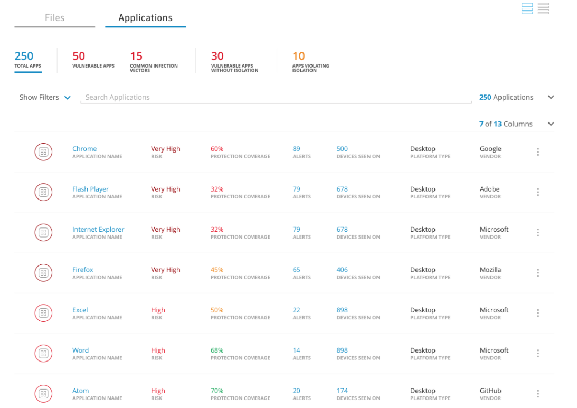
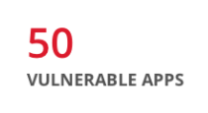
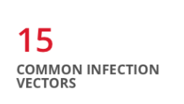
Assess & Classify Every Application
Auto-classify all installed and running apps
Identify Suspicious Apps
Analyze attack surface for Known Good Apps
Notes:
Auto-classify all installed and running apps (including exe files that have not yet been installed, i.e. on the hard drive)
Identify Suspicious Apps - Out of box risk categorization based on apps source, behavior, signer, whitelisting status and reputation and powered by Symantec File Insight & tunable with intensive protection from SEP 14
Analyze attack surface for Known Good Apps - Assess vulnerabilities for known good applications and identify top applications that need protection; powered by Symantec DeepSight
Auto-classify all installed and running apps
Identify Suspicious Apps
Out of box risk categorization based on apps source, behavior, signer, whitelisting status and reputation
Powered by Symantec File Insight & tunable with SEP Intensive Protection
Analyze attack surface for Known Good Apps
Assess vulnerabilities for known good applications and identify top apps that need protection
Powered by Symantec DeepSight

Slide 86








Isolate Suspicious Apps and Defend Known Good Apps
Executable Files
Suspicious ->
Full Isolation
Good File ->
No Restriction
WWW
Content Files
Shield browsers and
email clients from
attacks
Monitor download activity and auto classify downloaded files
Automatically isolate
suspicious executable files
Shield applications from weaponized content
86
Notes:
How SEP Hardening Works?
Shield browsers and email clients from attacks. They are the main source of how files and attachments are downloaded (common infection vectors)
Auto-classify downloaded files and email attachments
If the file is an exectubale, classify it by risk. If suspicious isolate it, if it’s a good file, no action needed.
If the file is a content file (Adobe, Microsoft, or others), shield it to prevent weaponized content from executing malicious activity; also block vulnerabilities from being exploited.

Slide 87

The SEP Hardening Difference
Application discovery and attack surface assessment
Automatic detection and isolation of suspicious apps
Low impact to end user productivity
Integrated with SEP – No additional agents
Notes:
Application discovery and attack surface assessment – Find all applications: running, installed or just on the hard drive as an executable. Determine risk of existing vulnerabilities to score each app.
Automatic detection and isolation of suspicious apps – Suspicious files will be automatically isolated to prevent them from executing privileged operations.
Low impact to end user productivity – Other vendors use a security envelope around each app which bogs down the system, our technology delivers better protection at minimal impact.
Integrated with SEP – no additional agents – Using the same single SEP agent, just configure and deploy for fastest time to value.

Slide 88
SEP Hardening – Protection against Threats Executed via Applications
LIST
(ENDPOINT)
LIST (USER)
Why Symantec?
NEED
“I need to protect my endpoints from infections that come in through suspicious or known good applications without compromising end-user productivity”
Enhanced visibility into all applications on endpoints as well as detailed vulnerability information
Low impact to end user productivity because we avoid using a restrictive and rigid envelope around applications
Integration with SEP so that SEP can automatically send suspicious apps to SEP Hardening for isolation
CHALLENGE
  To enable end users with the ability to download and use any application safely
PRODUCT
  Symantec Endpoint Protection Hardening
CAPABILITIES
  Discover and classify applications on the endpoint
  Isolate suspicious applications
  Shield commonly used applications from vulnerability exploits
88

